Slide 1
Ferrero detector
Giudice Gianluca, Formenti Matteo

Slide 2
Task
Classify rocher boxes as valid / invalid
Identify errors in the boxes

Slide 3
DATASET

Slide 4
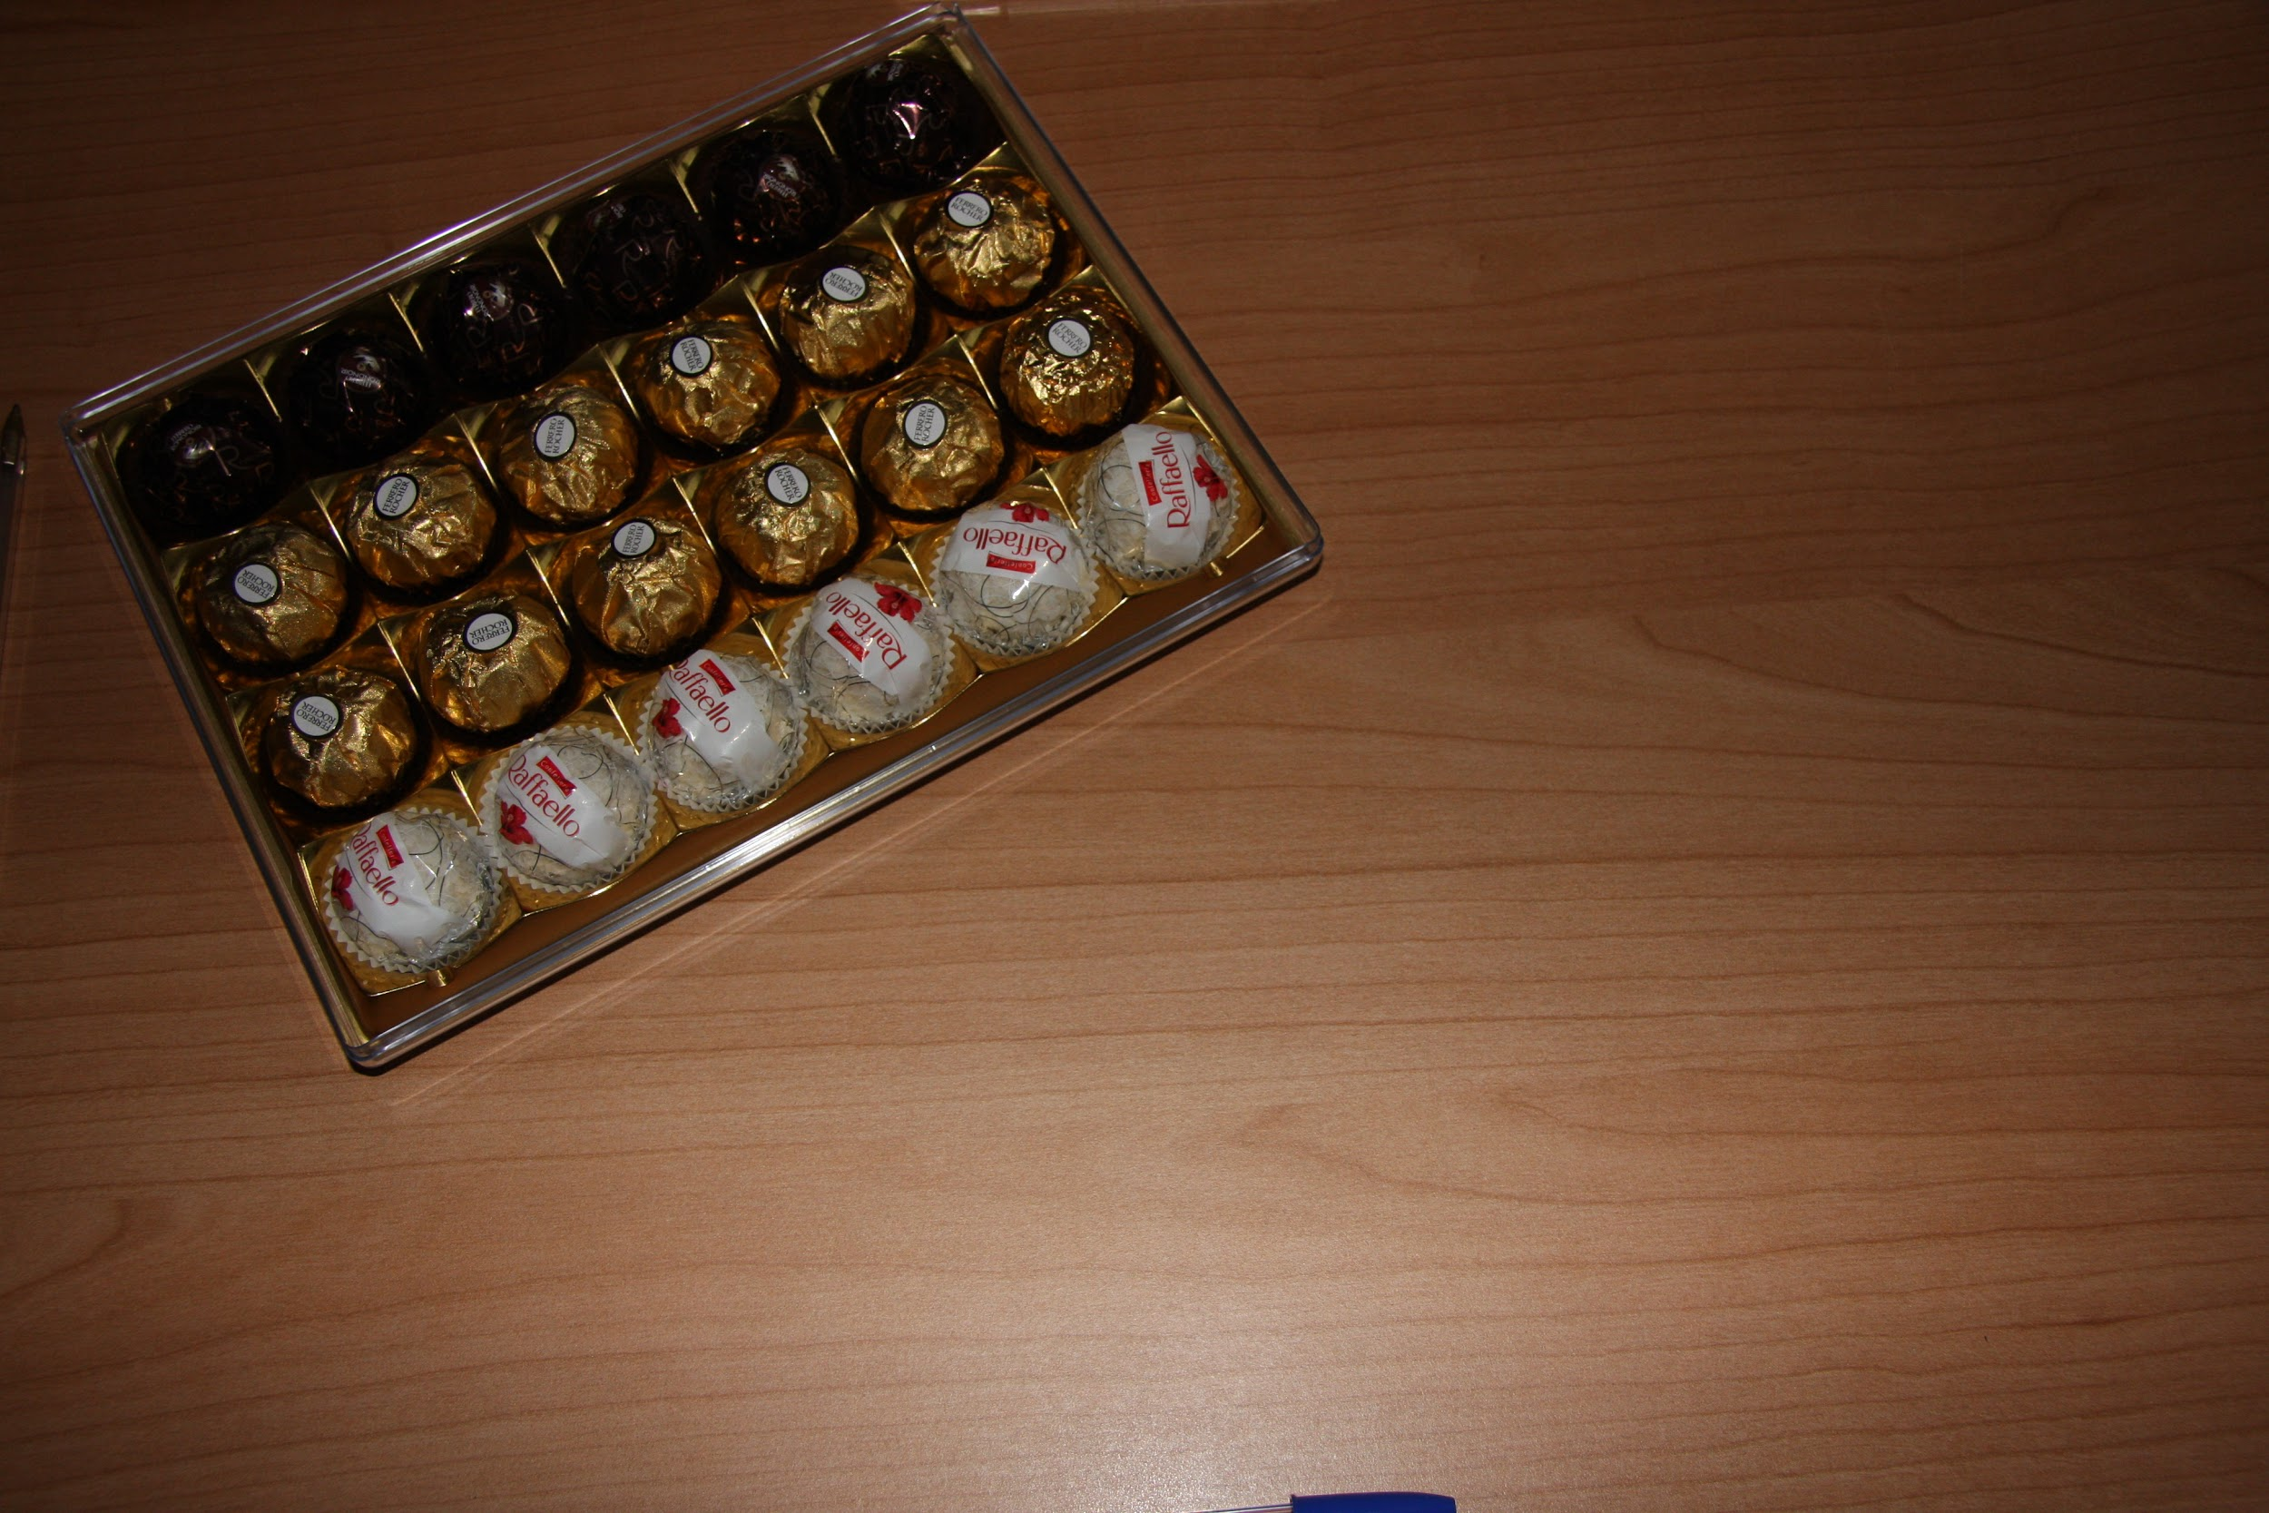
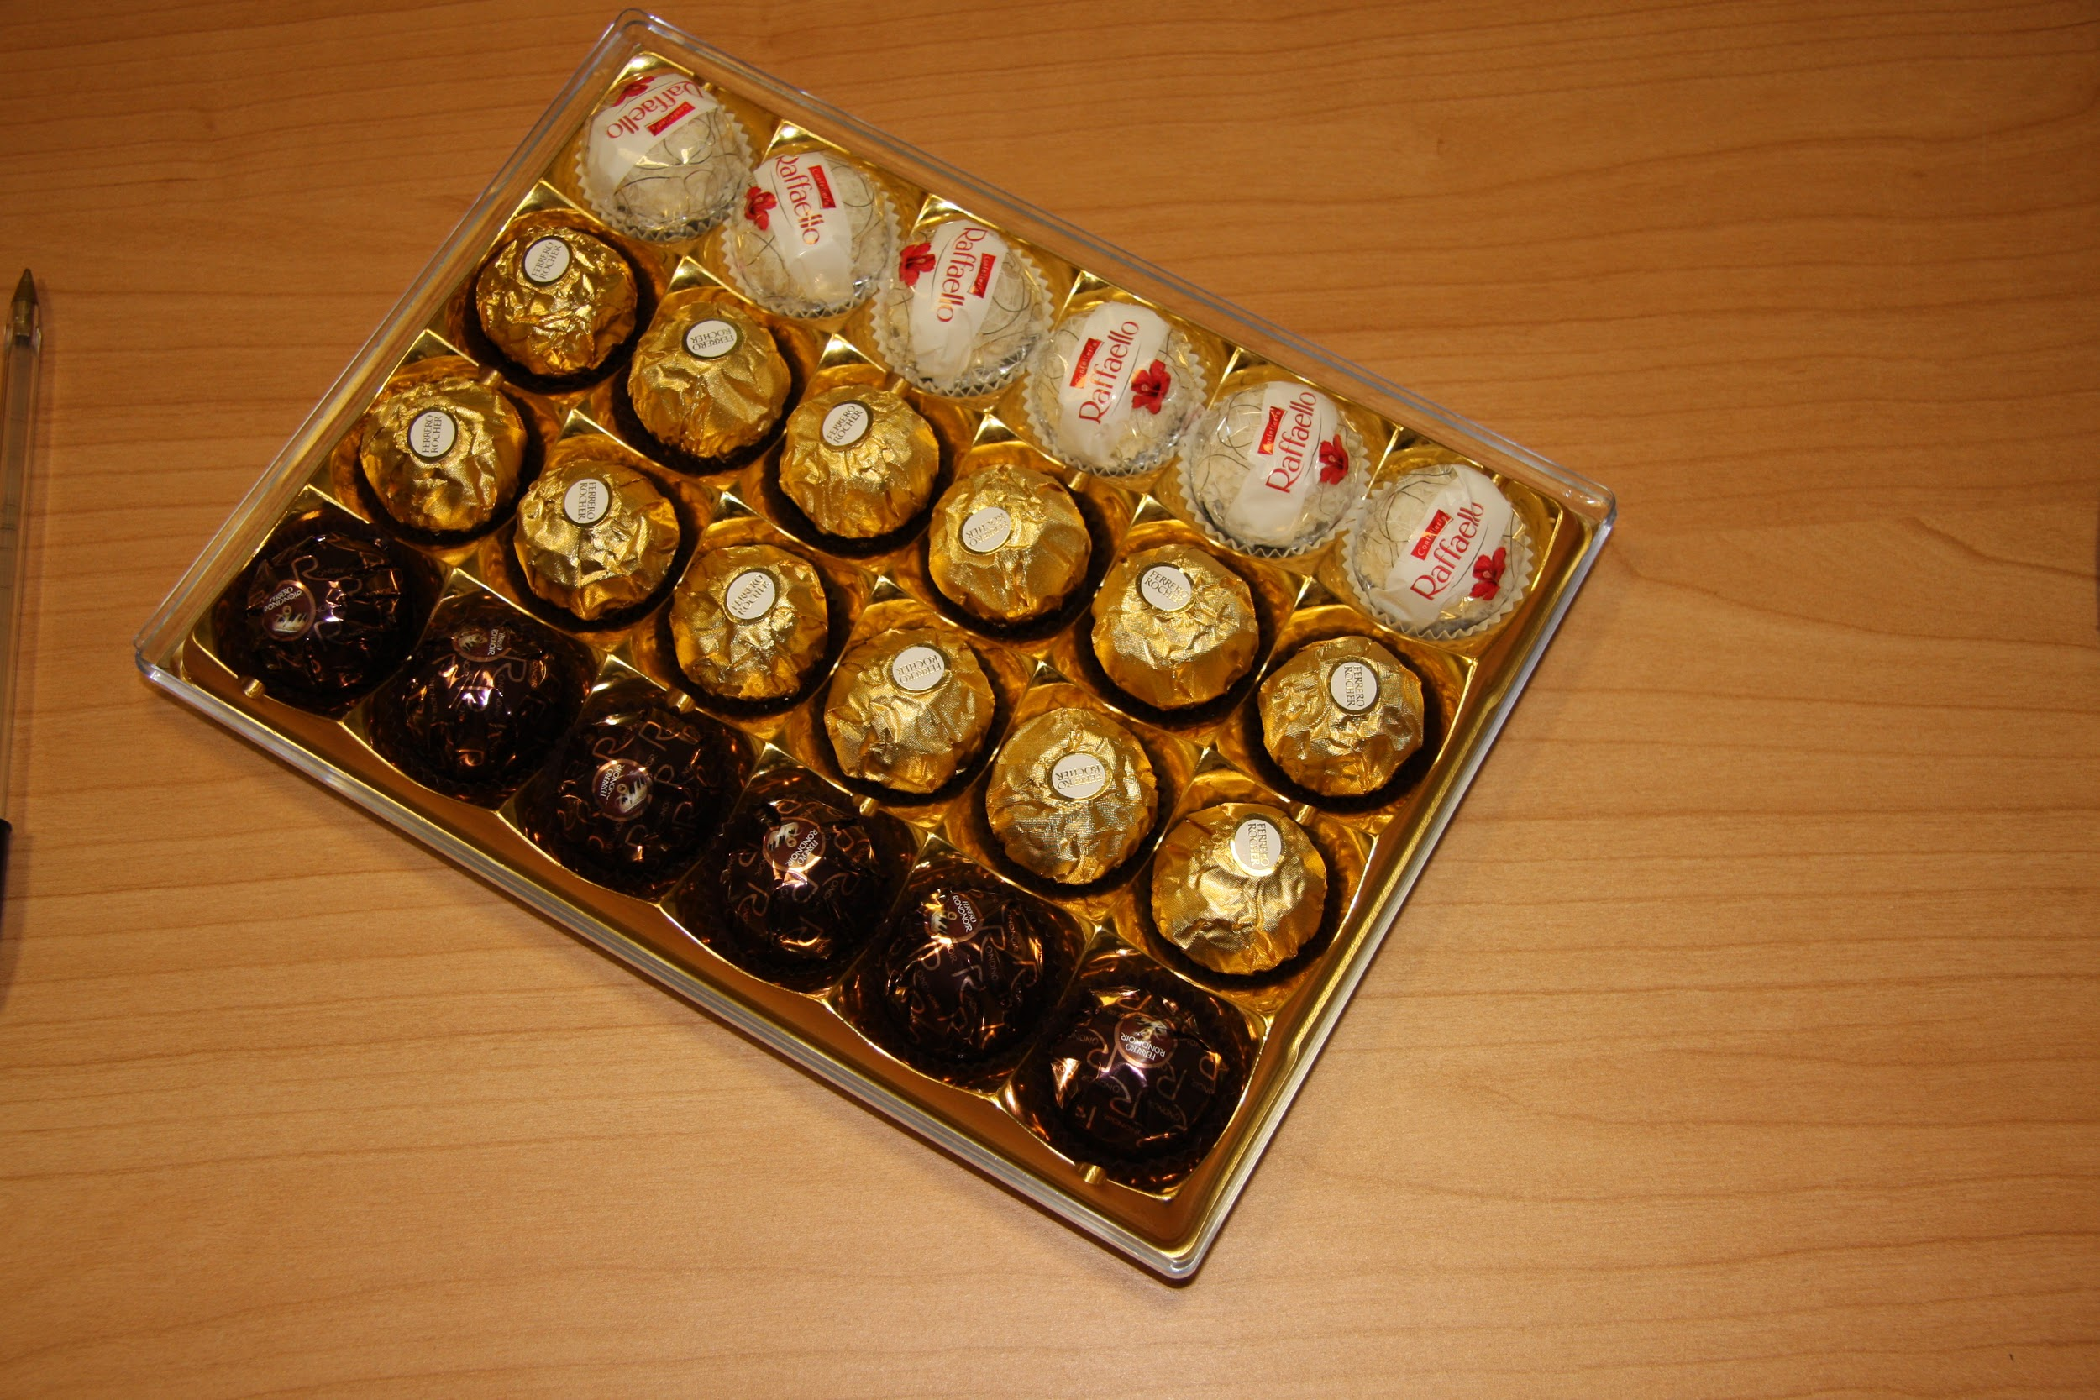
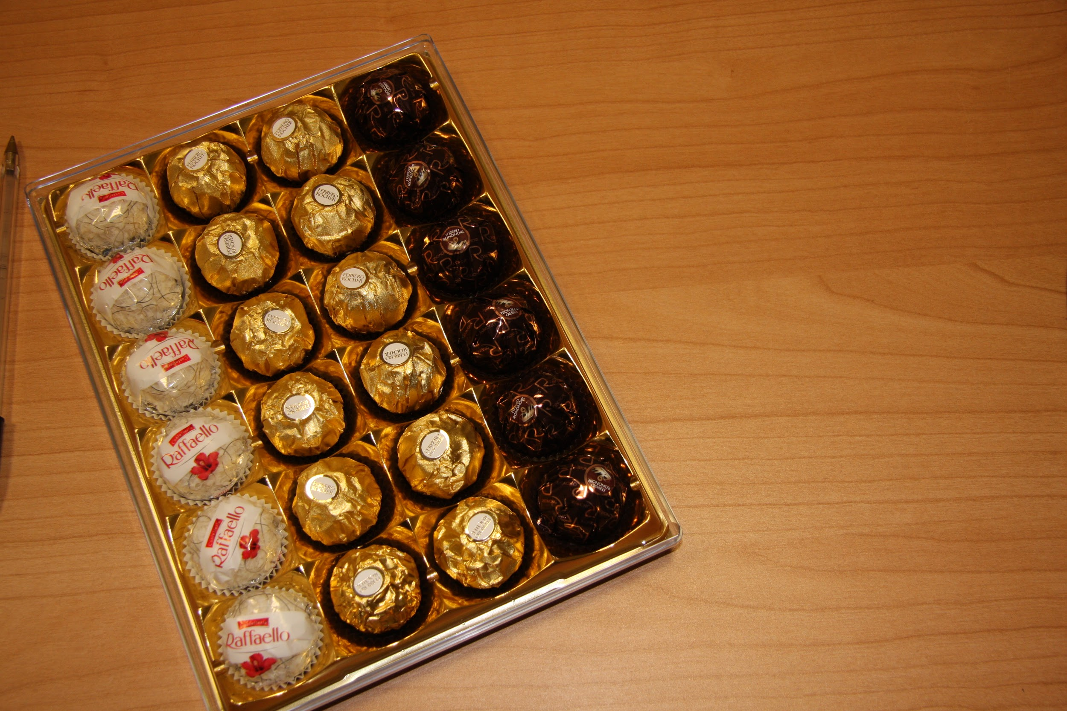
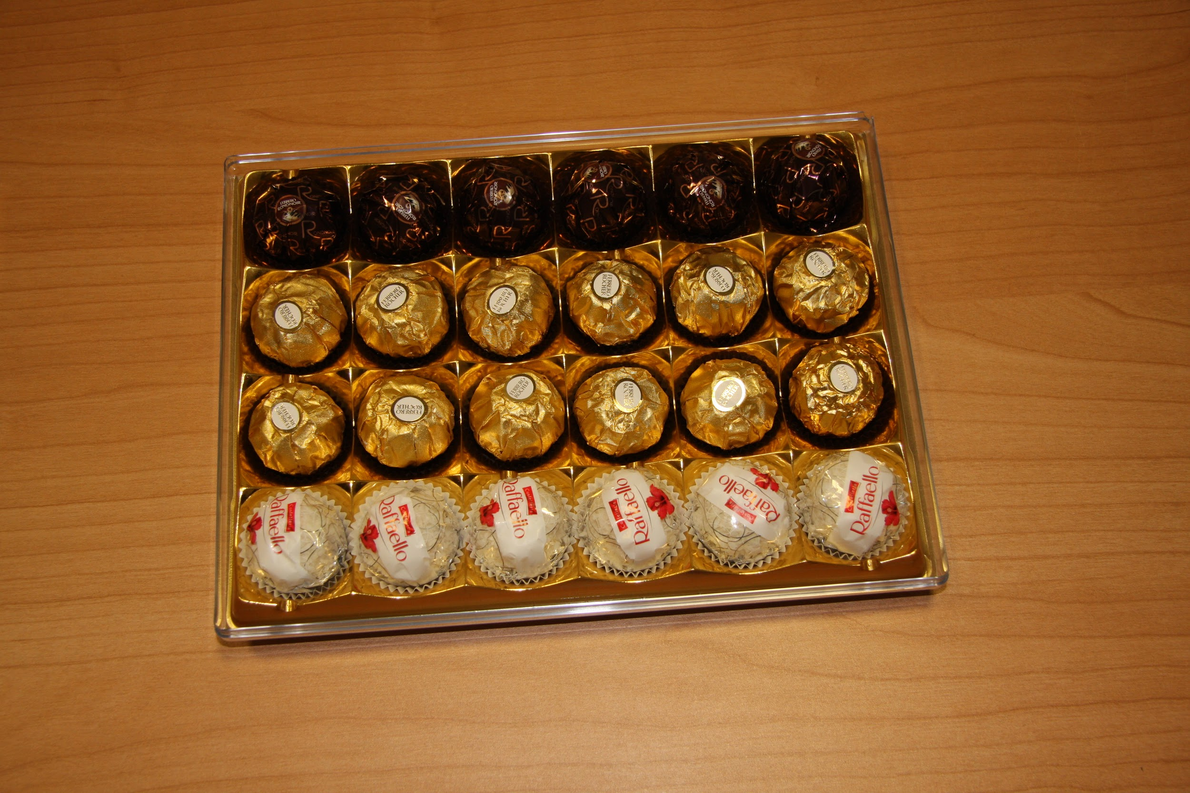
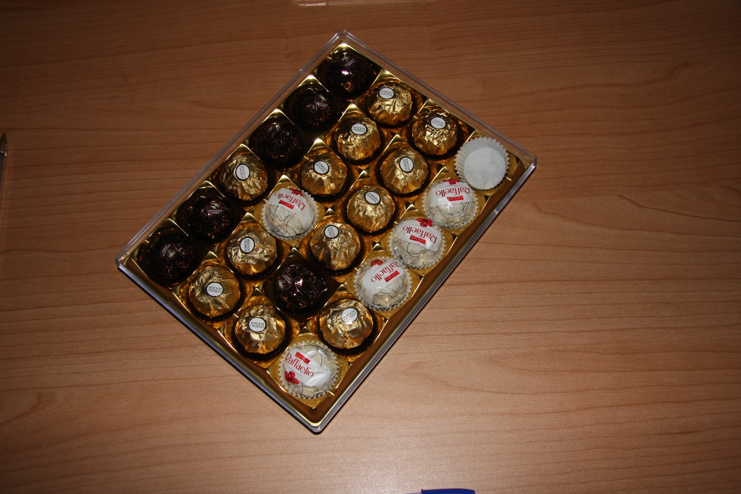
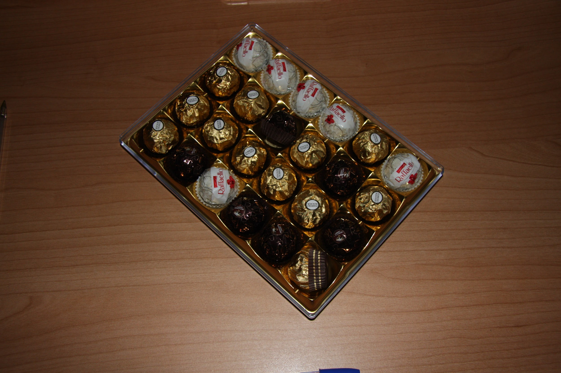
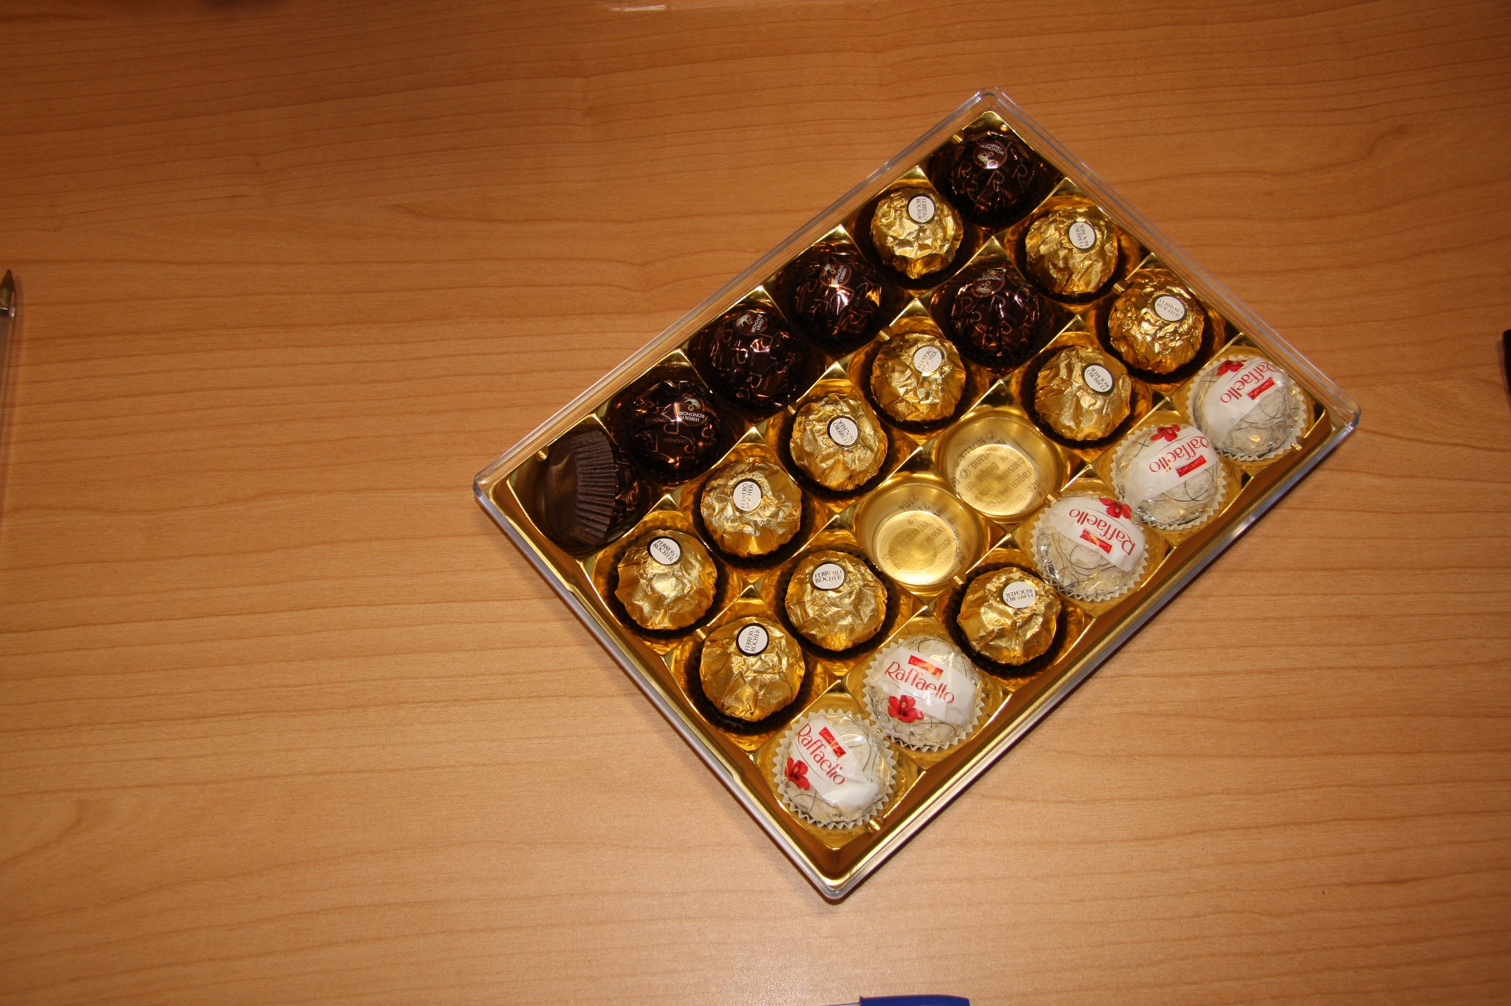
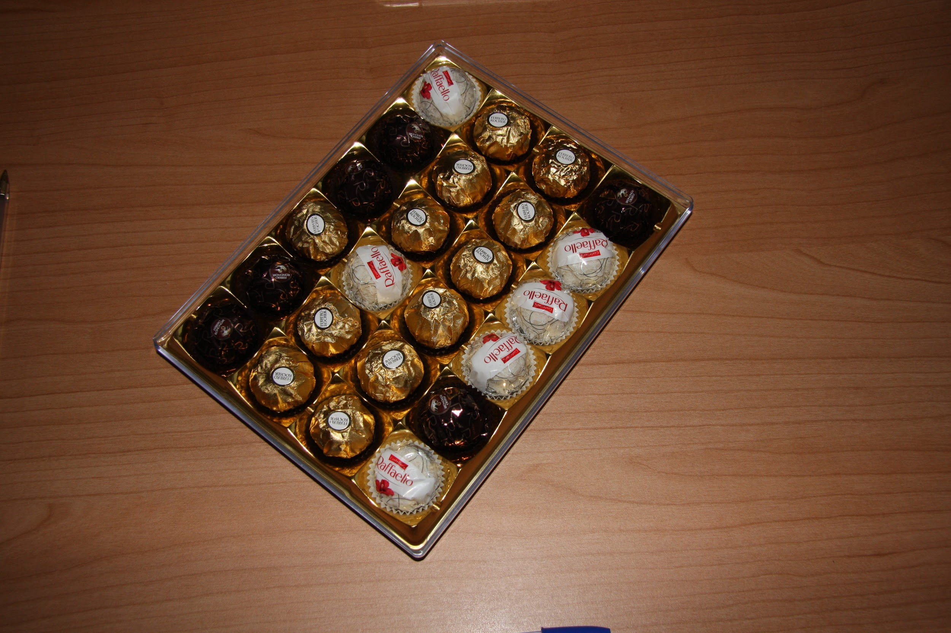
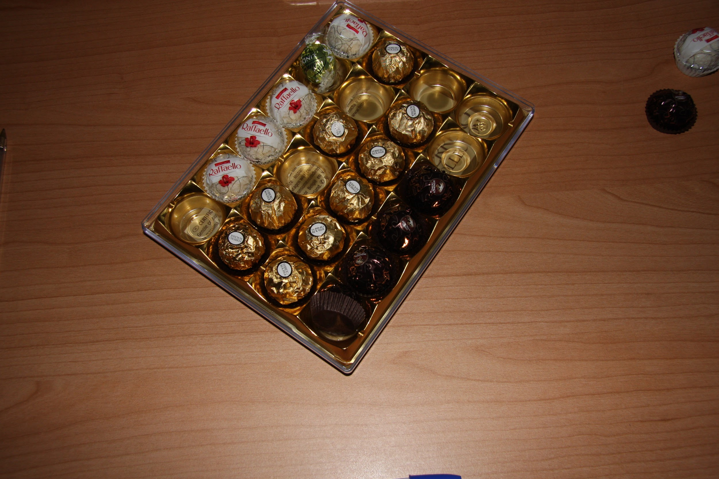
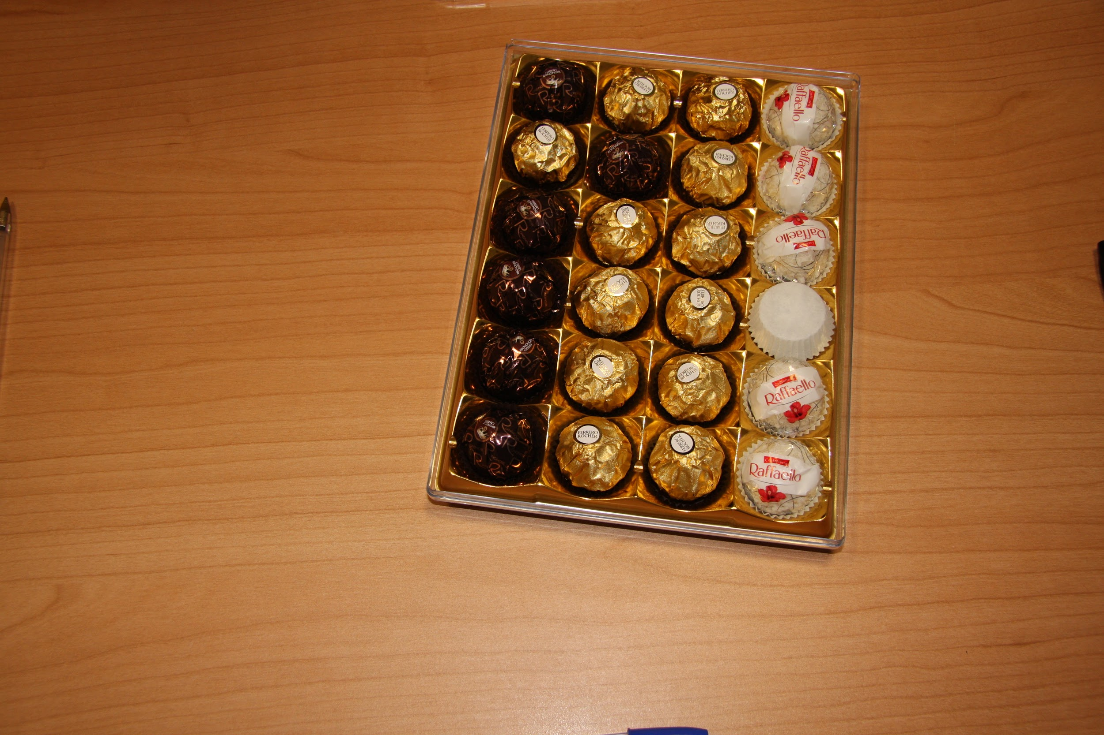
RECTANGULAR BOXES

Slide 5
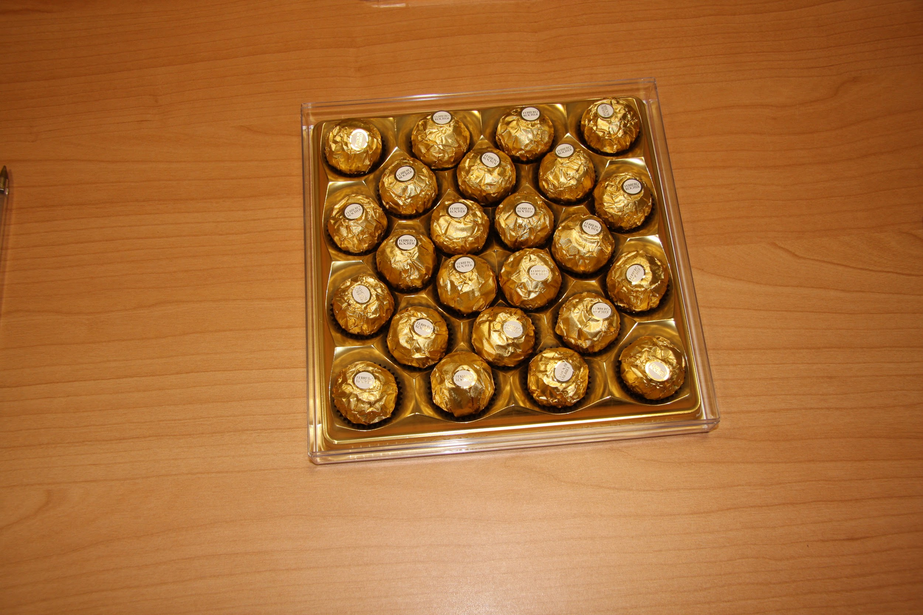
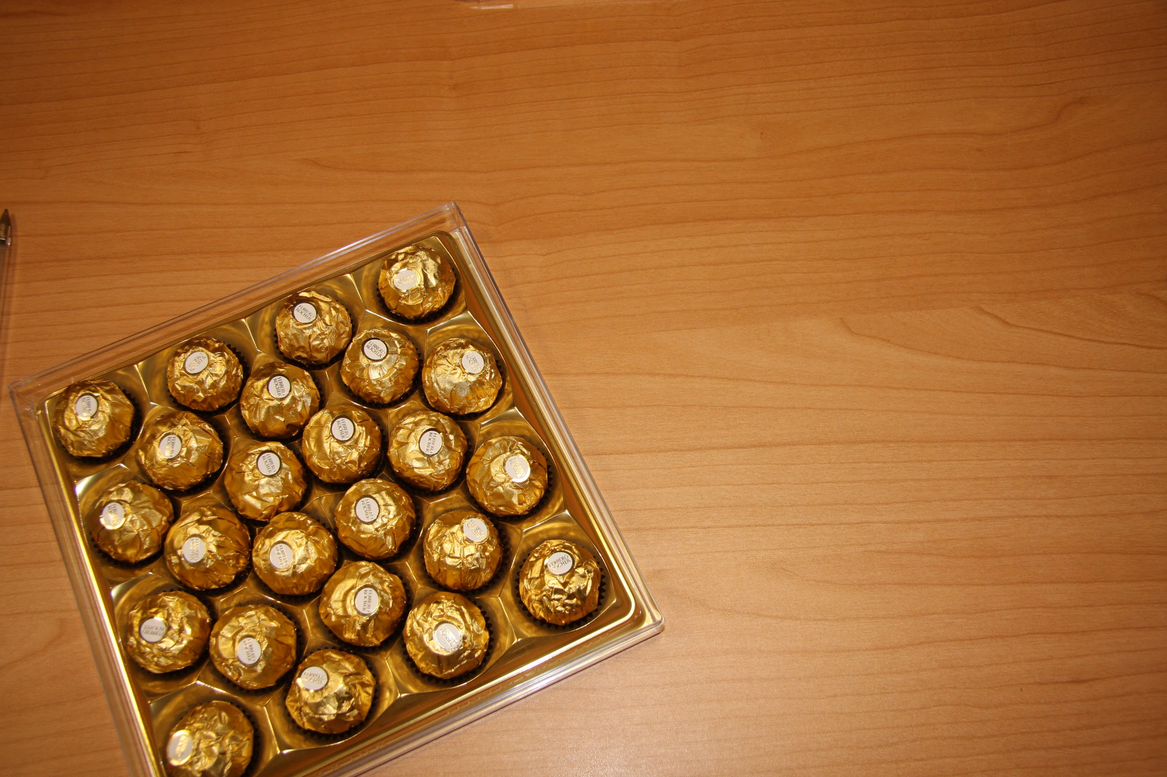
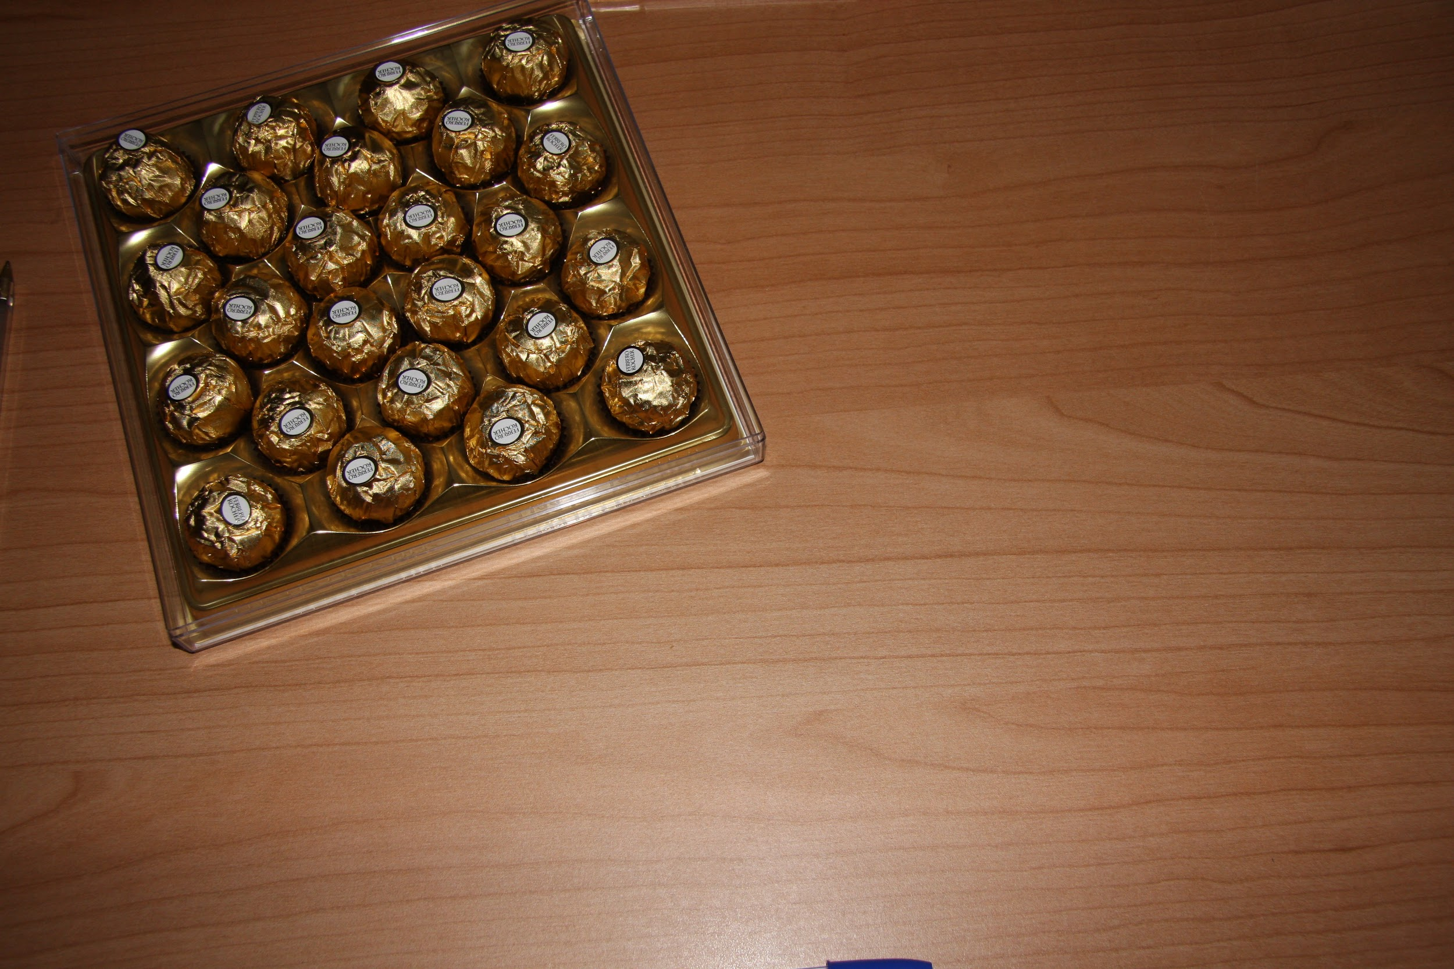
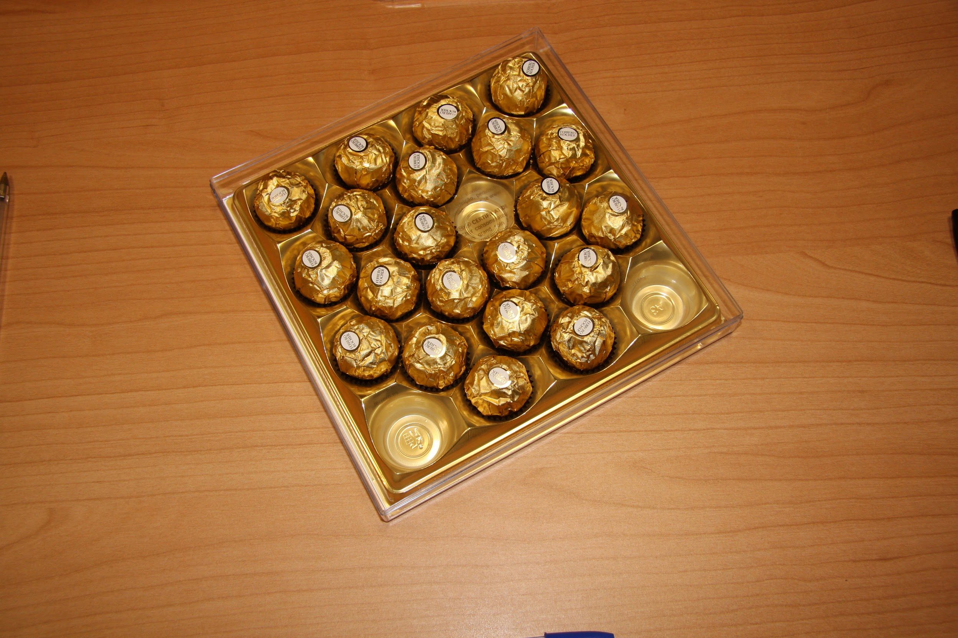
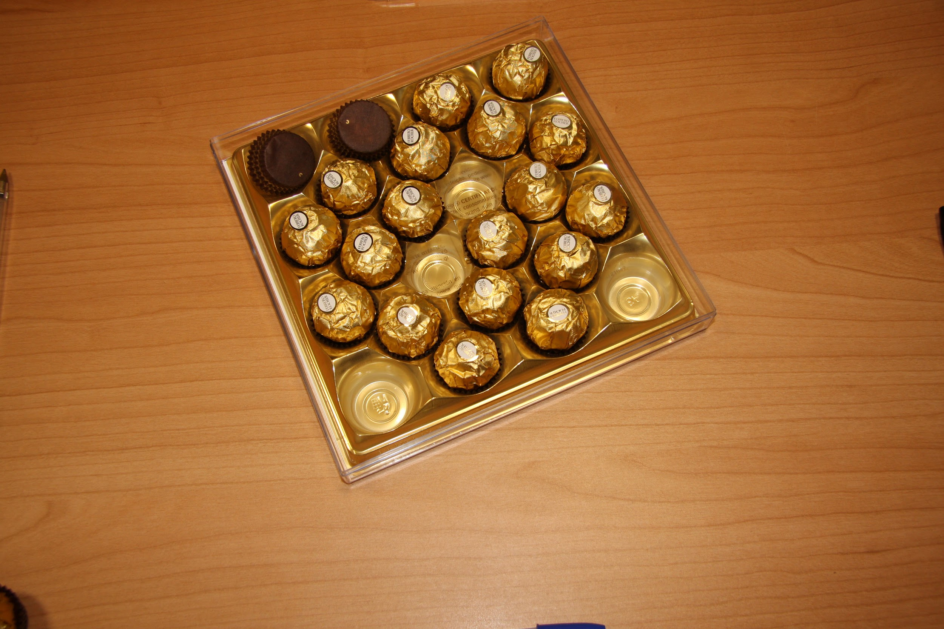
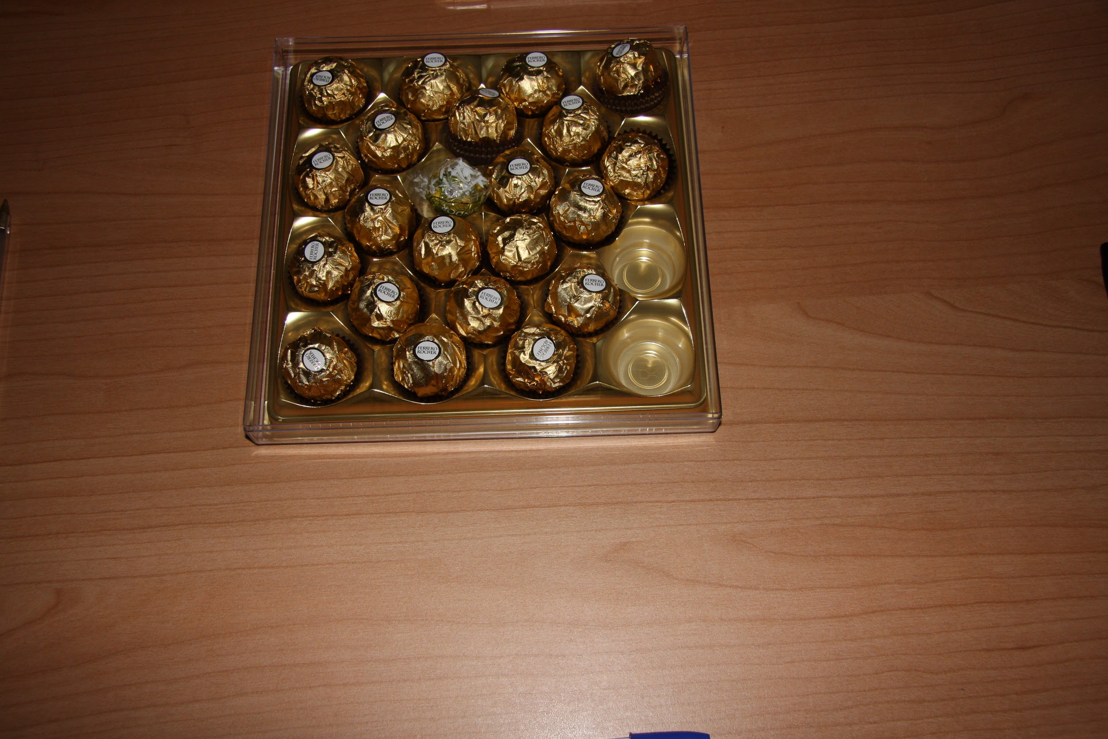
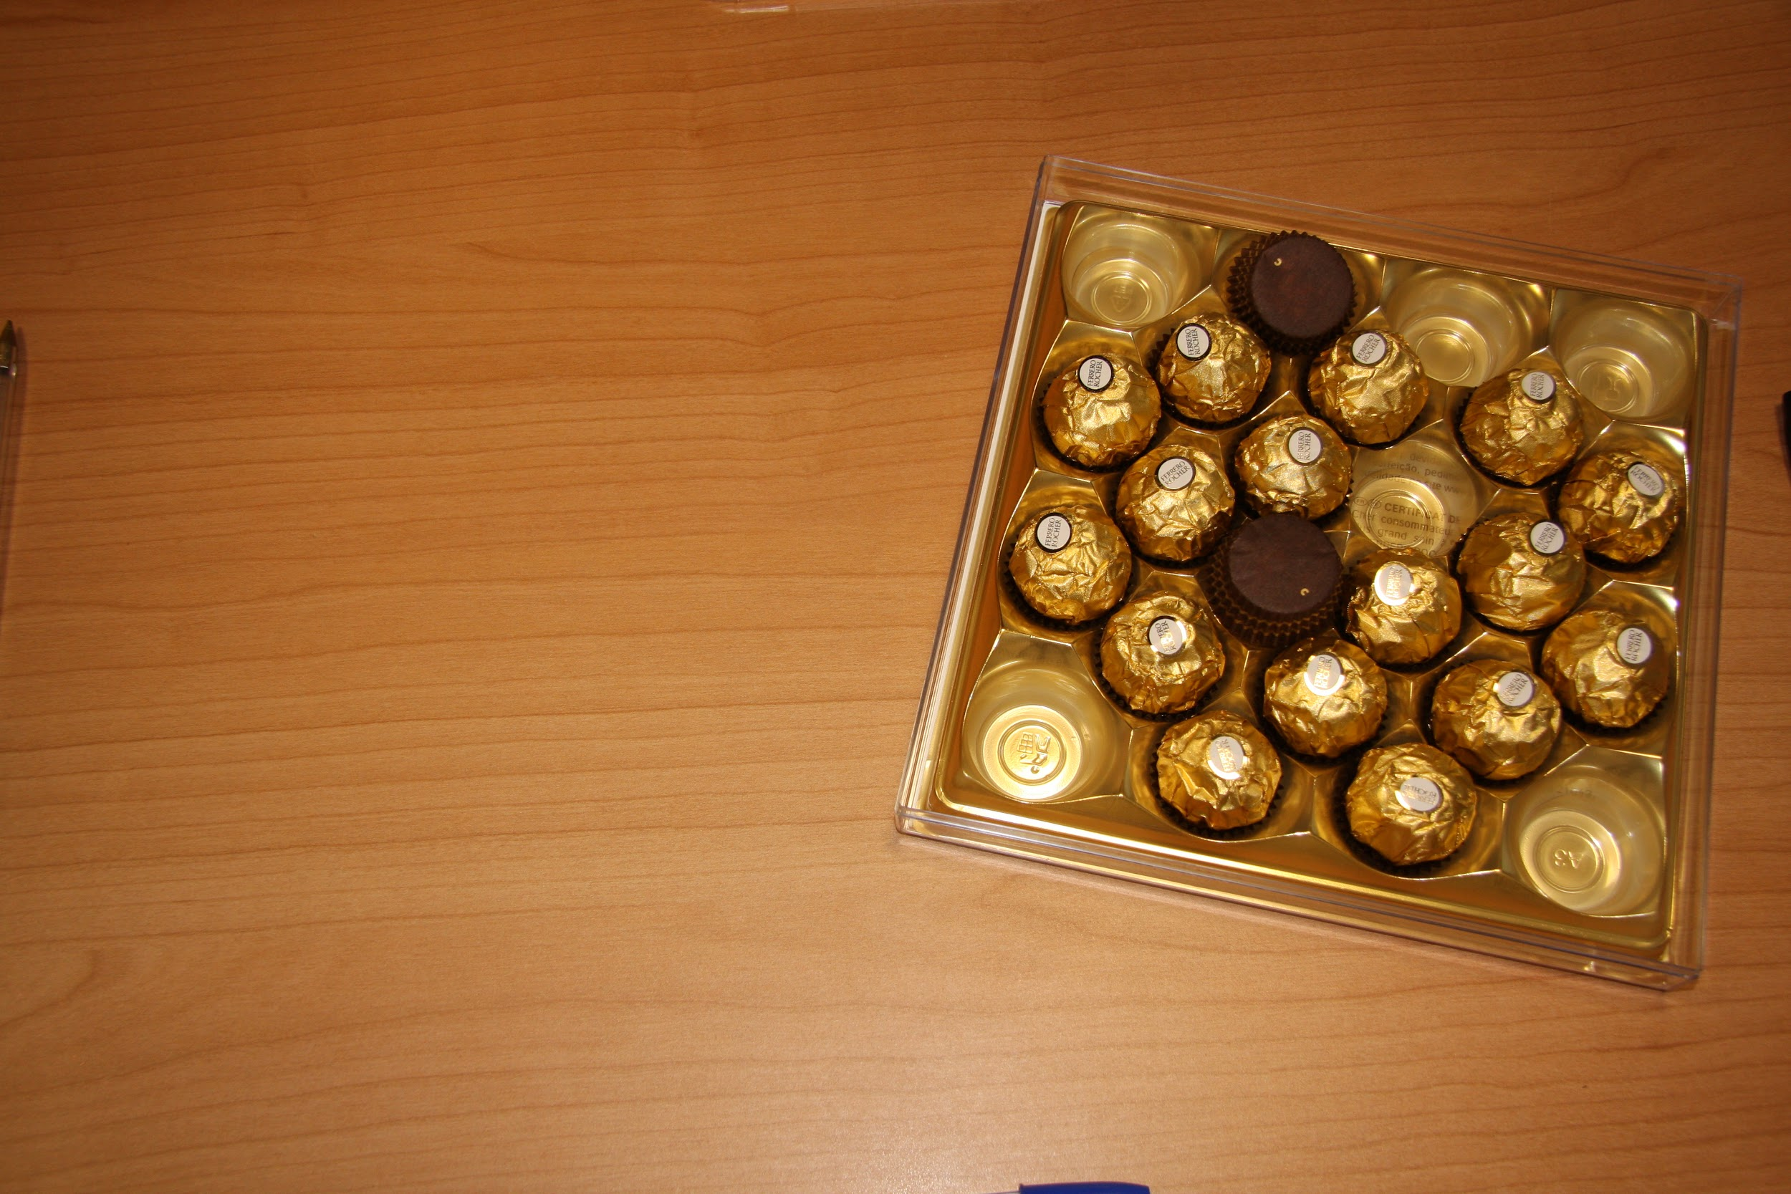
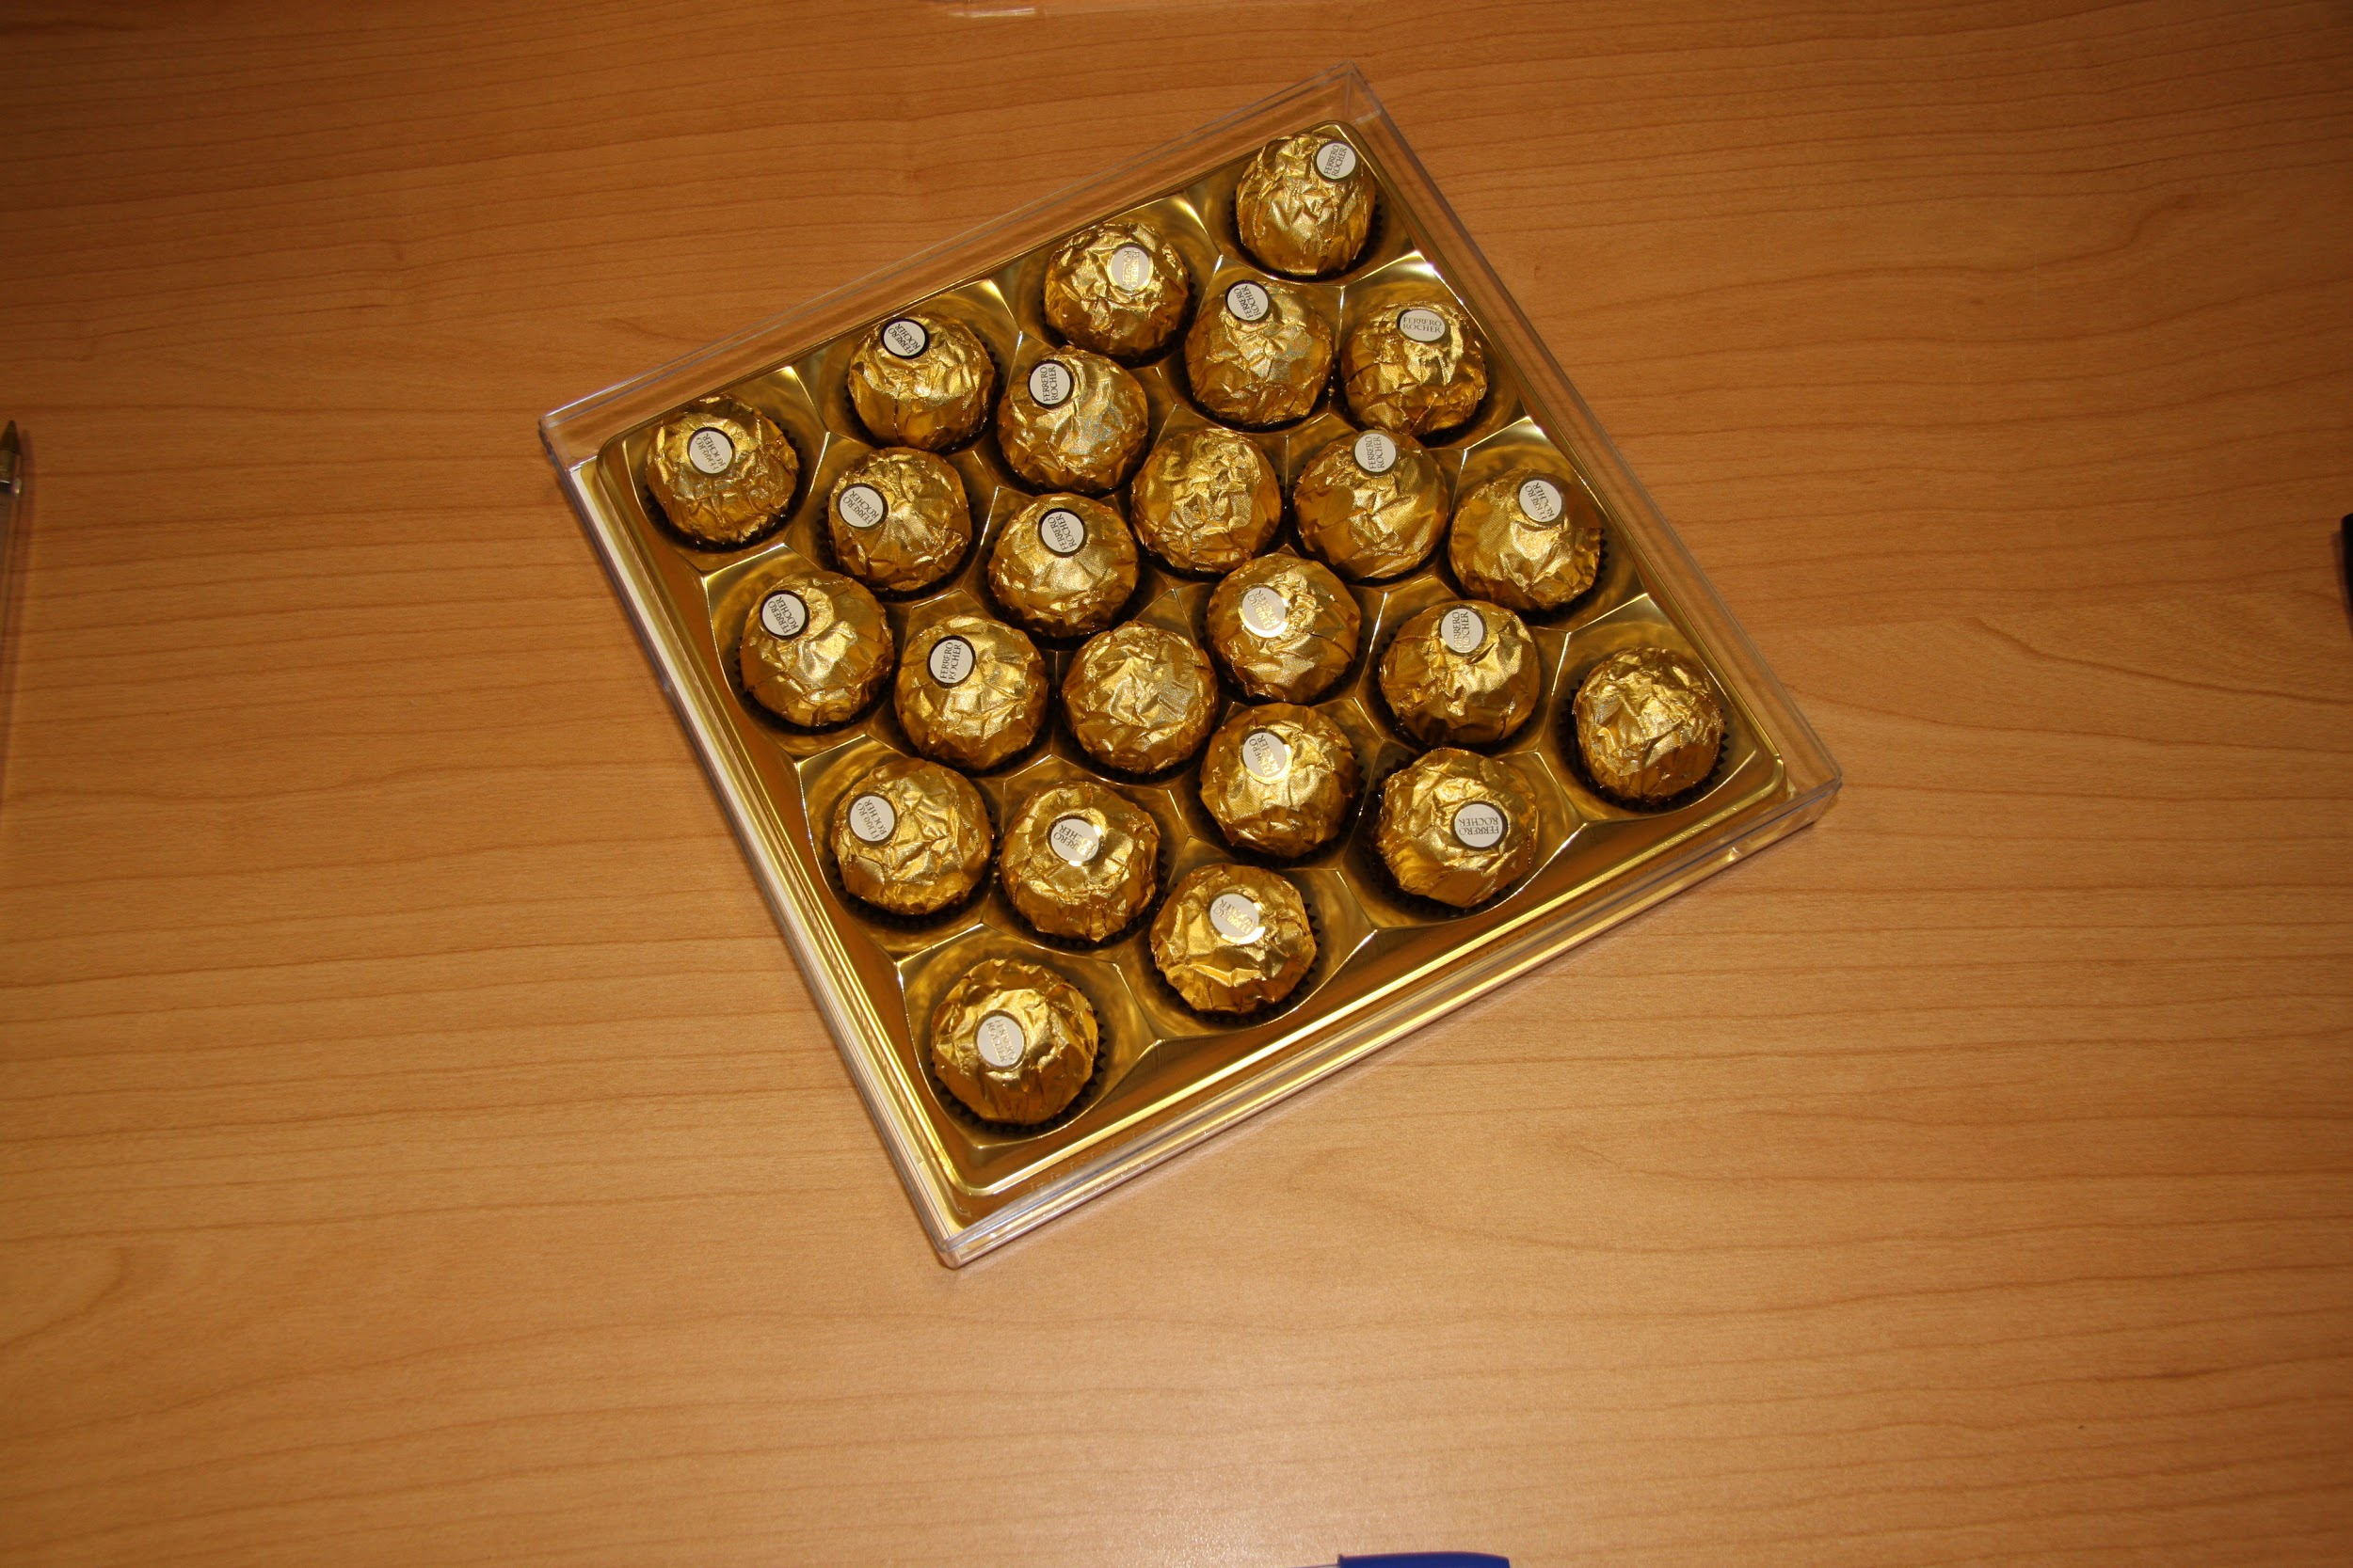
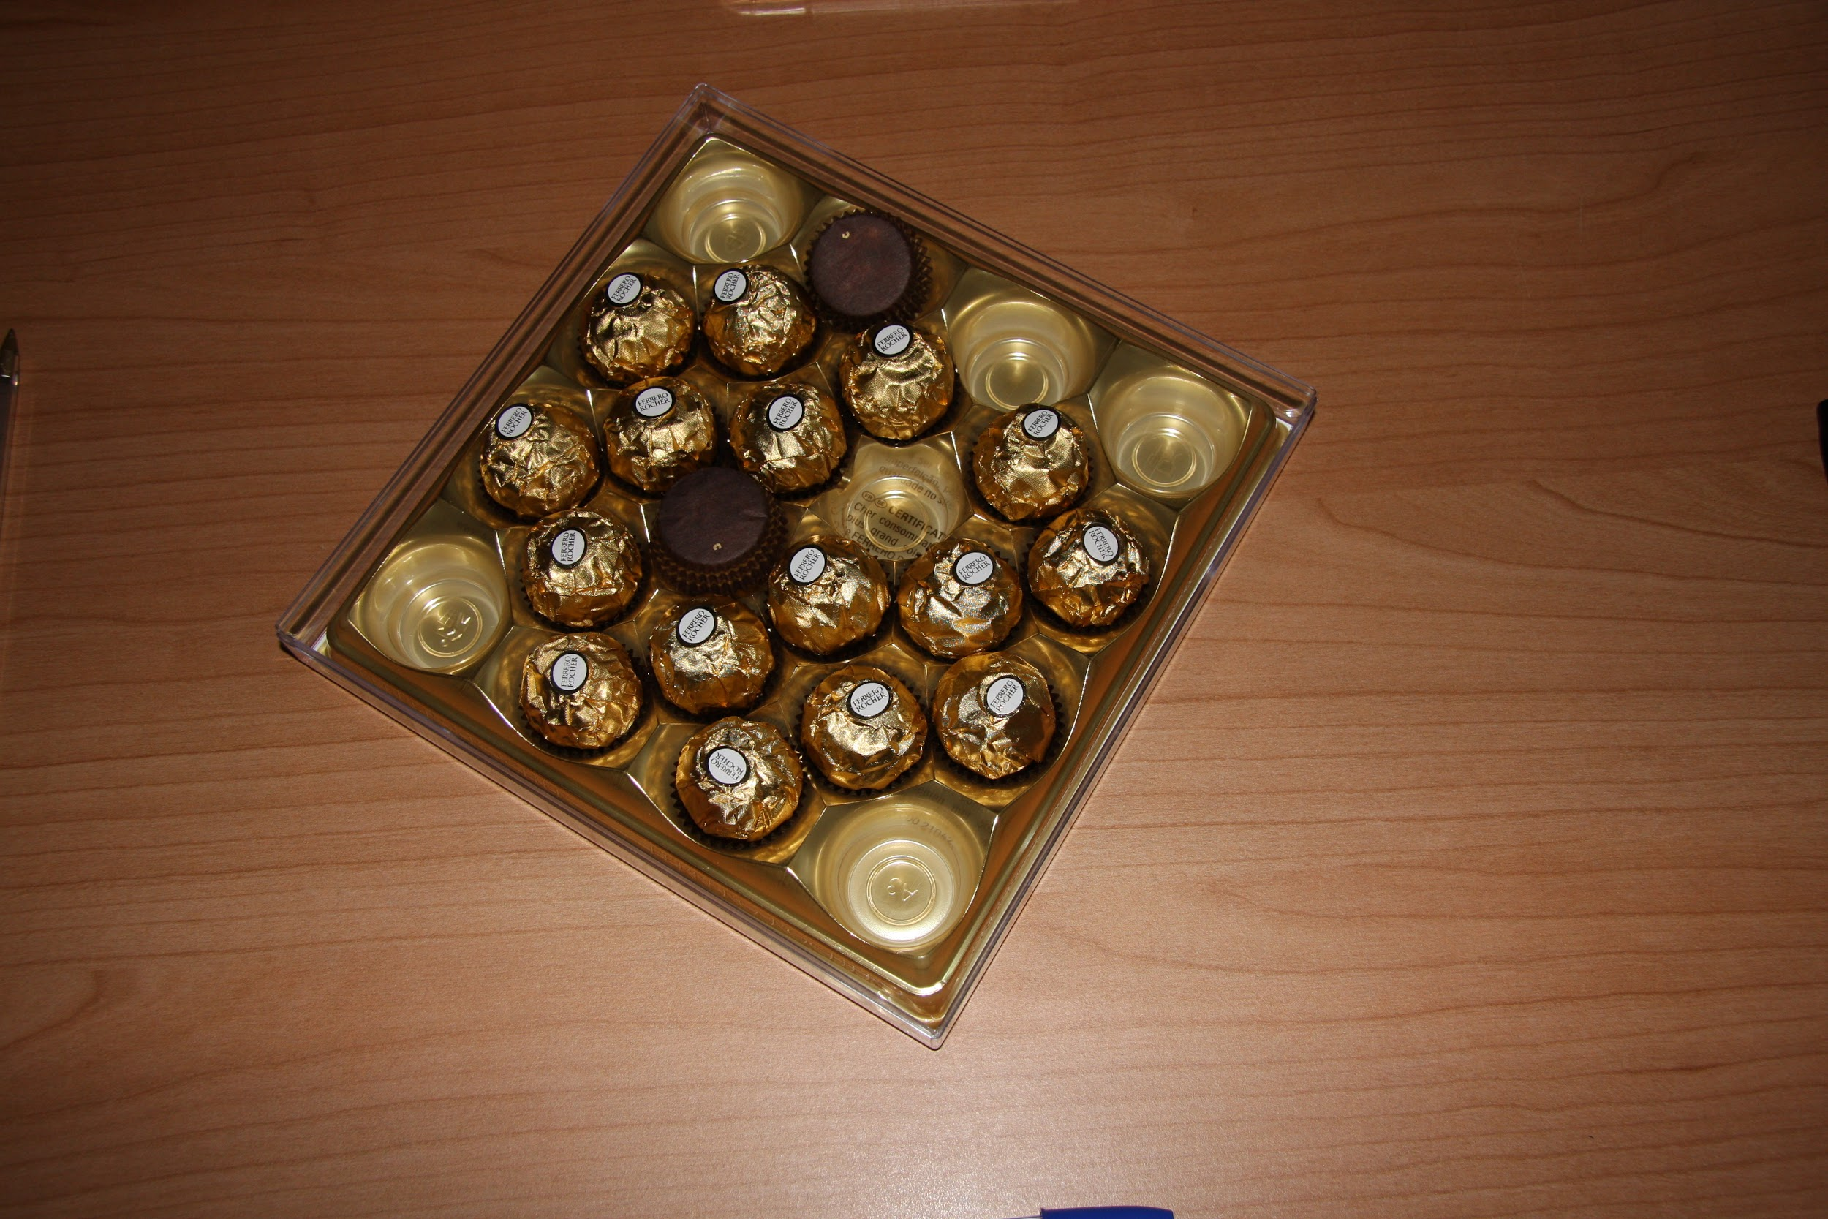
SQUARE BOXES

Slide 6
Macro step
Box detection
Vertices detection
Box classification
Perspective adjustment
ROI Classification
Error detection

Slide 7
BOX
DETECTION

Slide 8
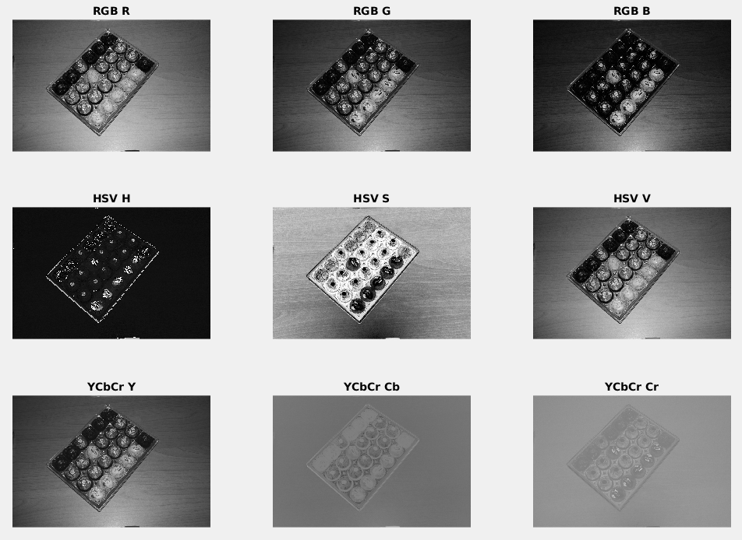
COLOR SPACE ANALYSIS
Color space analysis is critical in order to detect the most viable color space that maximizes the contrast between box and table. A qualitative analysis shows that Cb and Cr are the most appropriate channels.

Slide 9
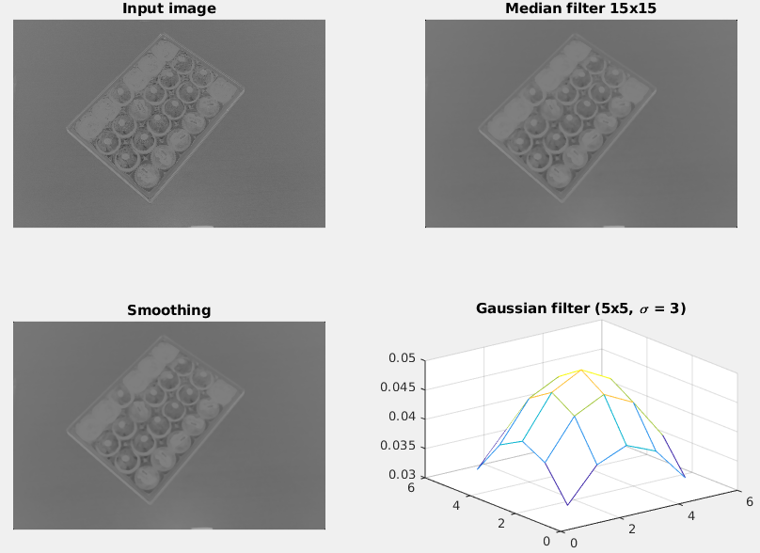
IMAGE ENHANCEMENT
Filtering the image allows for higher box detection precision, the objective is to smooth as much as possible the background, so that edges are detected only inside the box. The following steps have been performed:
Cb channel isolation
Image resizing to a fixed dimension (allows for faster processing and static filter dimensions)
Scaled image median and gaussian filtering

Slide 10
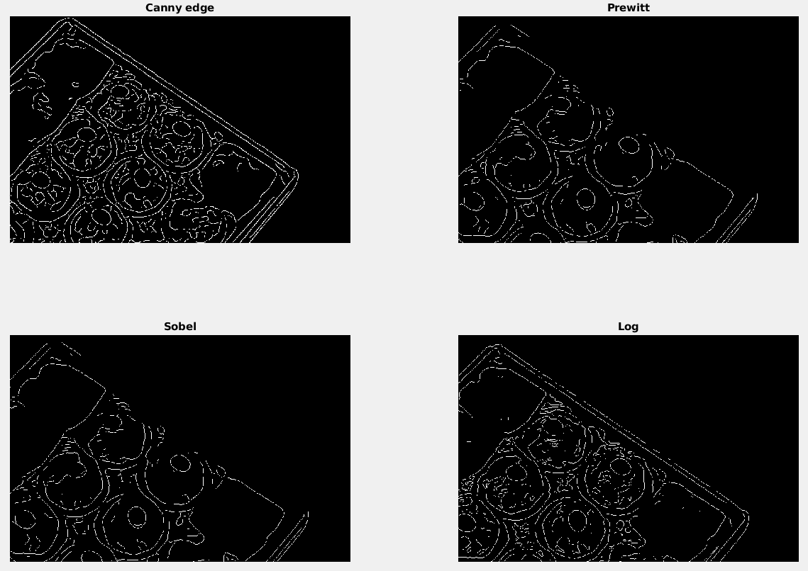
EDGE DETECTION
Canny edge detection returns a very “noisy” image in the box region (caused by the variance between all chocolates) and a somewhat clean image over the table. Using this image allows the algorithm to distinguish between box and table: high edge presence is classified as box or other objects, low edge presence is table.

Slide 11
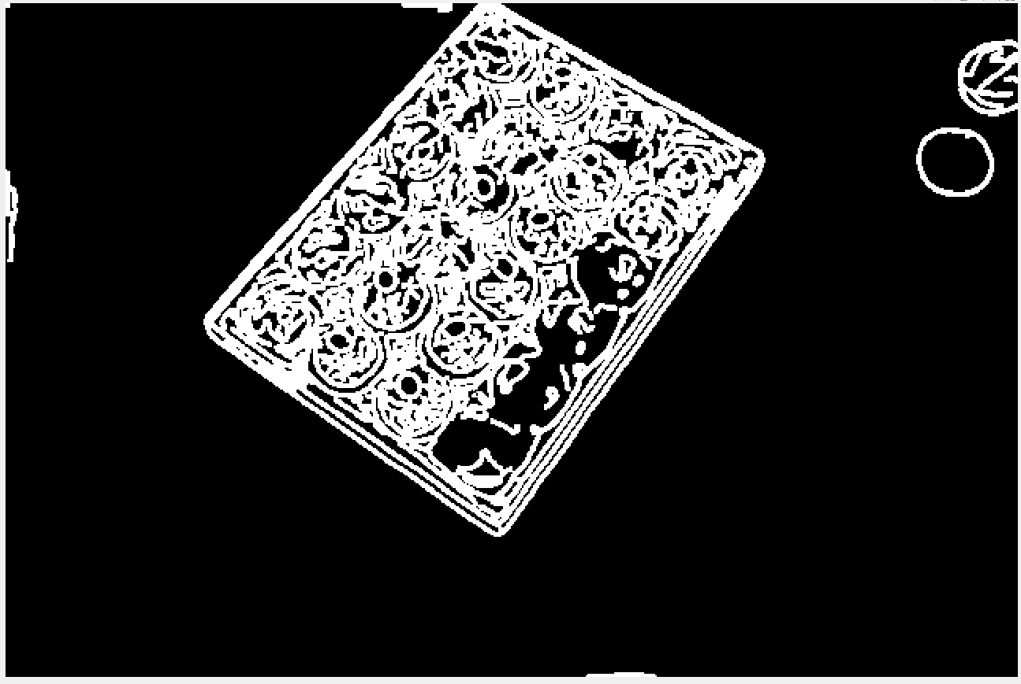
BOX DETECTION
The edge image is binarized using a sliding mask of size ≈ ½ of the box edge, so that the transparent box is correctly classified. The image is considered box if the sum of all pixels beneath it is greater than 0.

Slide 12
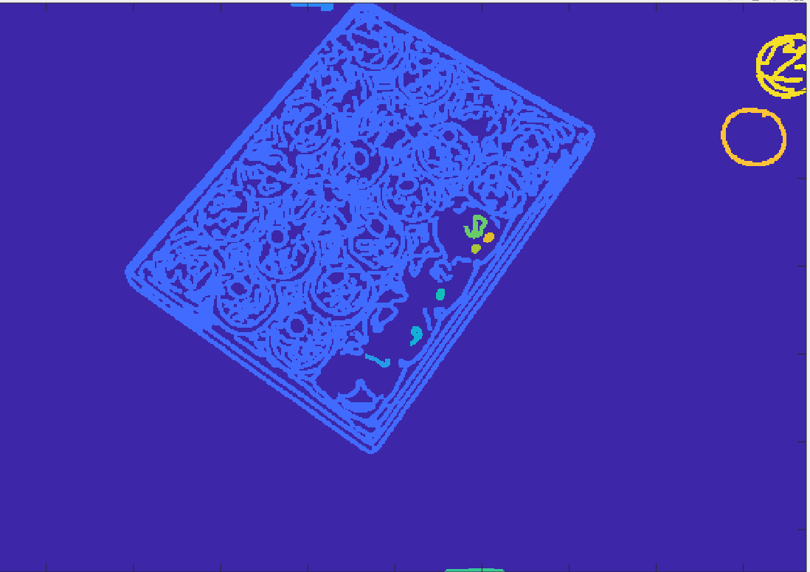
OBJECT REMOVAL
Connected regions labeling is performed on the binarized image, only the biggest component is maintained. Smaller regions are deleted (ie the two circles outside the box)
ASSUMPTION: the box is the largest component of the image

Slide 13
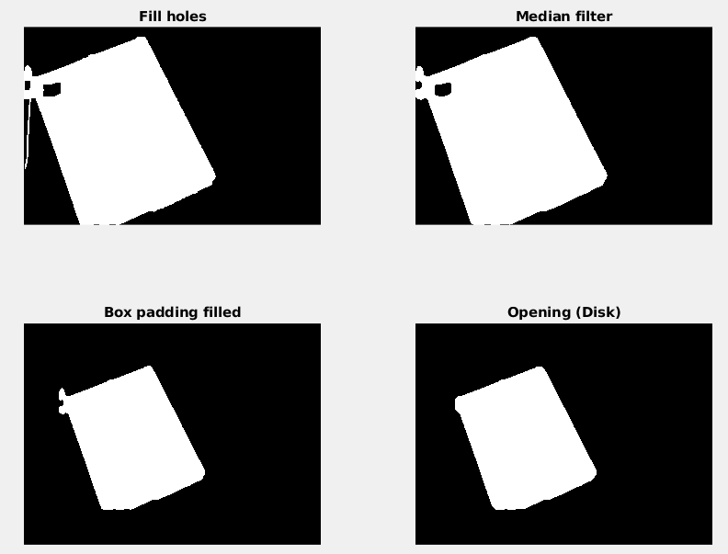
SHAPE CLEANUP
Holes, bulges and recesses are removed using mathematical morphology. This step is critical for the next one.

Slide 14
VERTICES
DETECTION

Slide 15
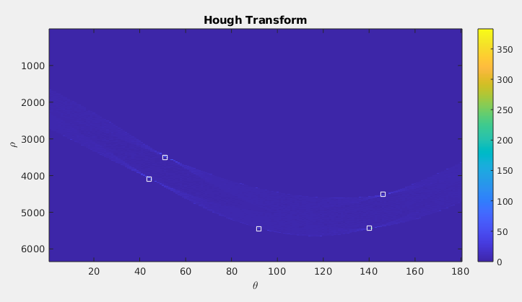
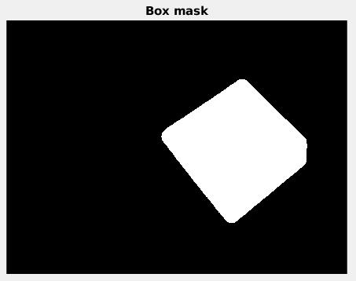
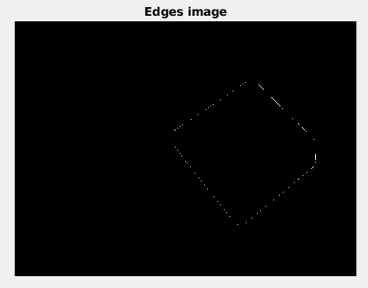
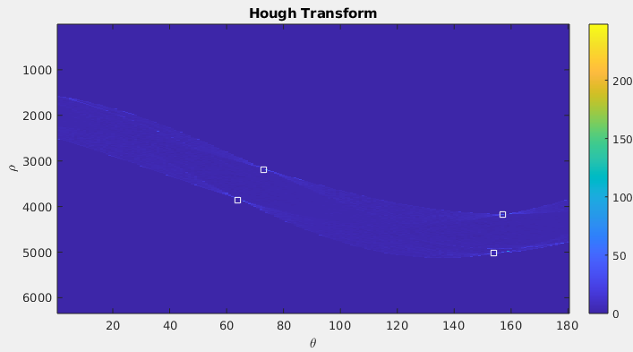
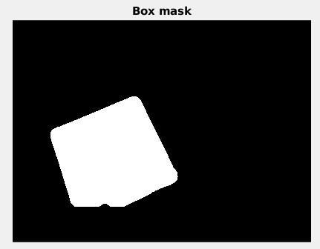
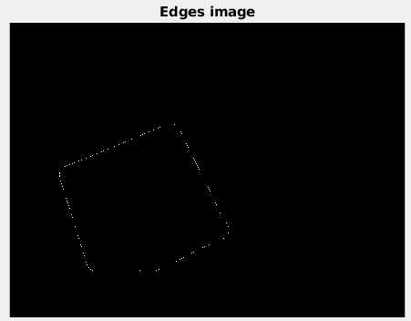
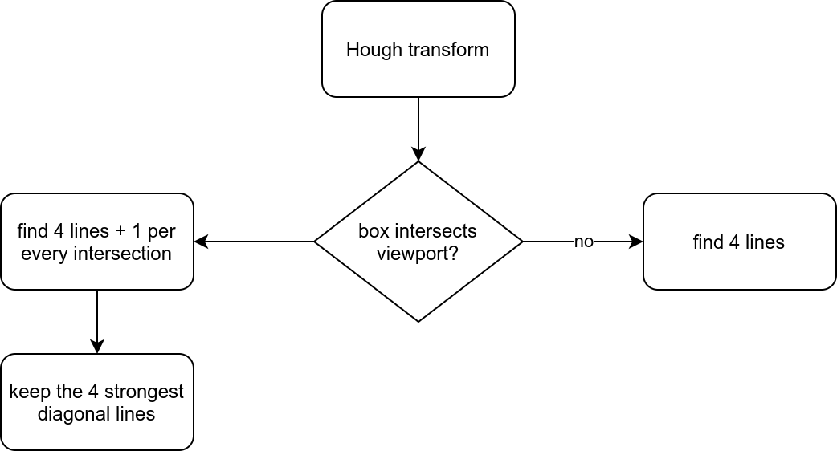
HOUGH TRANSFORM
Hough transform is performed on the image to detect the lines that compose the box. By finding the correct number of lines it’s possible to detect all edges, even the ones outside the image.
If the box intersects with the image border, it should not be parallel with any side of the image

Slide 16
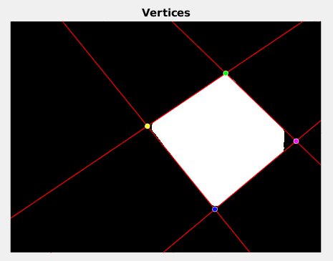
VERTICES DETECTION
The detected 4 lines are then used to calculate 4 vertices inside of the padded viewport. The green region shown is the image, some adding is added to allow for vertices outside the original image.
All 4 vertices can be outside of the image and this method still can find them. Vertices outside the padded image aren’t calculated since those are the focal points of the perspective.
Convex hull is then calculated to sort the vertices, then the list is sorted so that the first two points make up the longest segment

Slide 17
BOX TYPE CLASSIFICATION

Slide 18
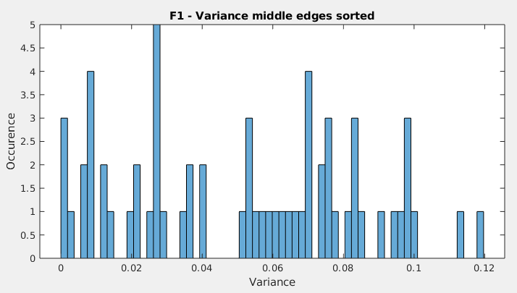
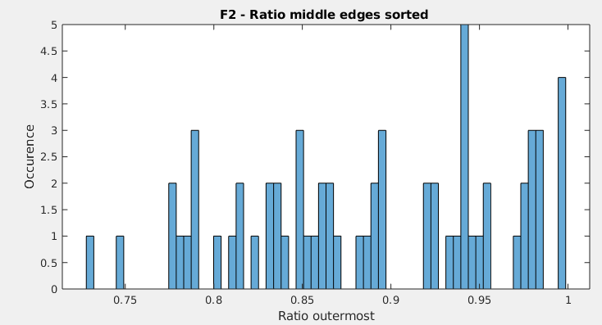
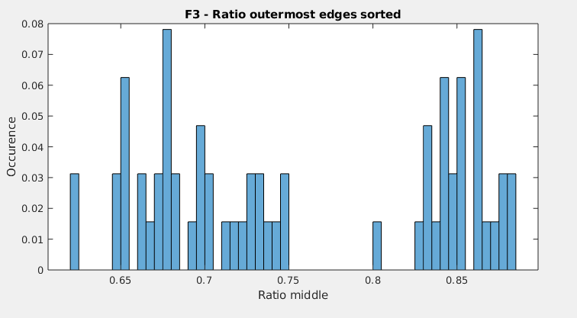
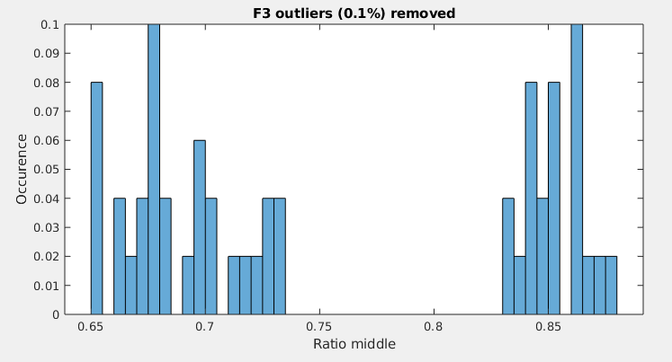
BOX TYPE CLASSIFICATION
The length of each side is computed, outliers are removed and using the ratio of the longest and the shortest side, the box is classified as square or rectangle.
Three features have been considered for the classification, F4 is the most accurate one
F1: Variance between medians
F2: Length ratio of medians
F3: Length ratio between longest and shortest
F4: F3 without outliers
Outliers incorrectly shift the classificator result

Slide 19
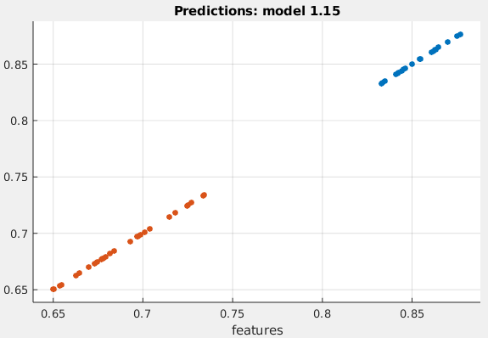
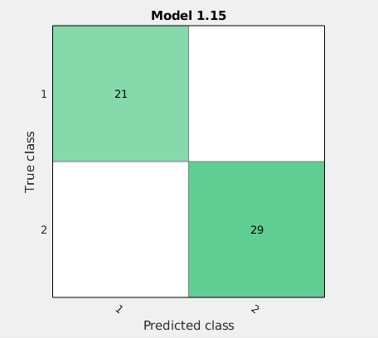
CLASSIFICATOR PERFORMANCES
Class 1 = square box
Class 2 = rectangle box
Classifier: 1-NN
6-fold cross-validation
ACCURACY = 100%
ACCURACY(with outlier) = 97%
6-fold cross-validation

Slide 20
PERSPECTIVE
ADJUSTMENT

Slide 21
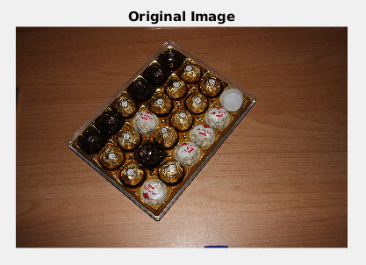
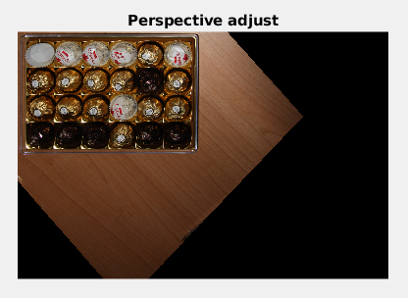
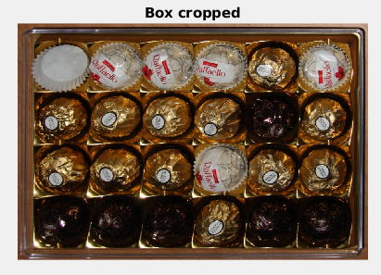
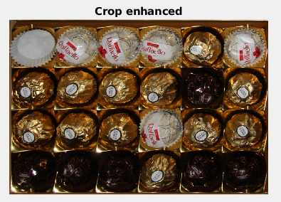
PERSPECTIVE ADJUSTMENT
After sorting all 4 vertices in order to have the longest edge first in the list, there vertices are then mapped into 4 fixed points (whose position is based on the box type).
The resulting image can then be cropped. Removing some padding from all sides simplifies the next steps since the calculated vertices are always outside the real box.

Slide 22
ROI
CROPPING

Slide 23
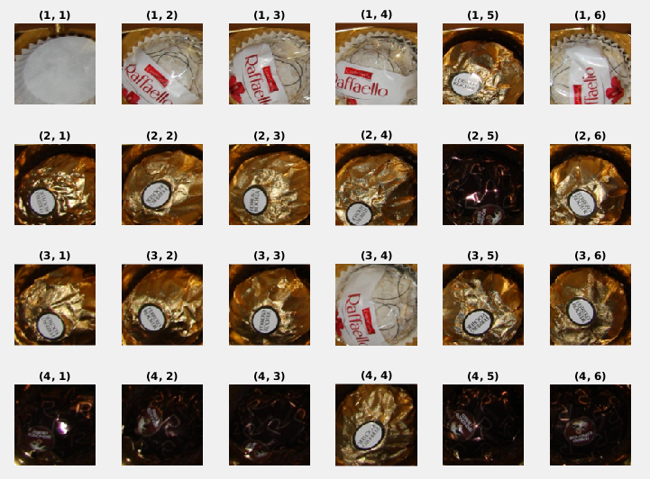
ROI CROPPING
Having the perspective correctly adjusted allow the algorithm to cut all chocolates precisely without additional processing.
A sample result is shown

Slide 24
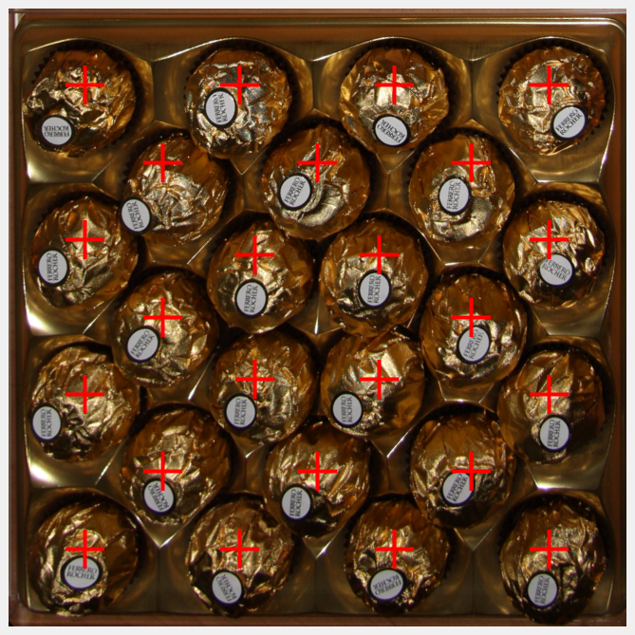
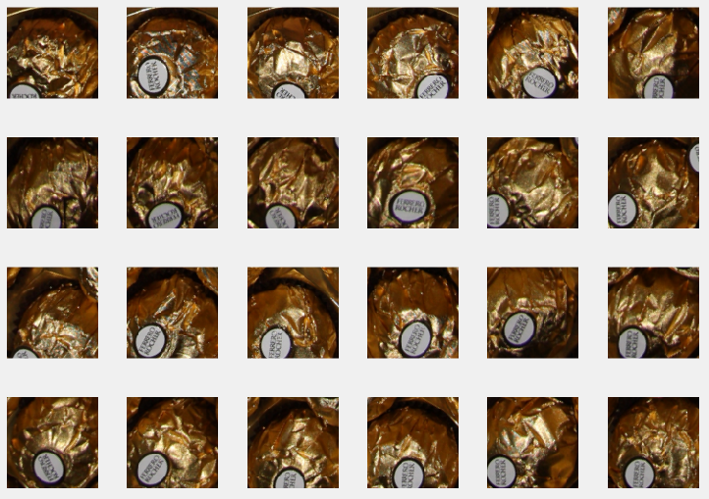
ROI CROPPING
The developed function allow for simple edit of cut parameters like radius and shape.

Slide 25
CLASSIFICATION
FEATURES

Slide 26
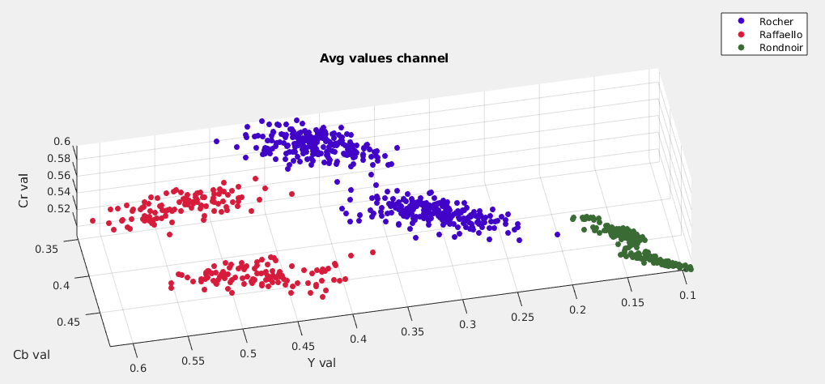
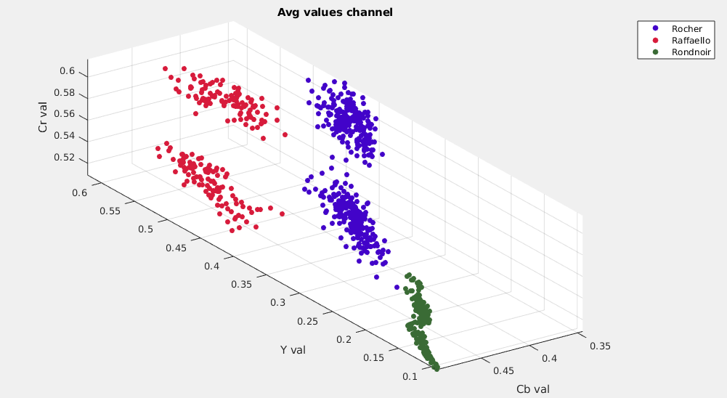
AVG YCbCr
YCbCr, average among all channels

Slide 27
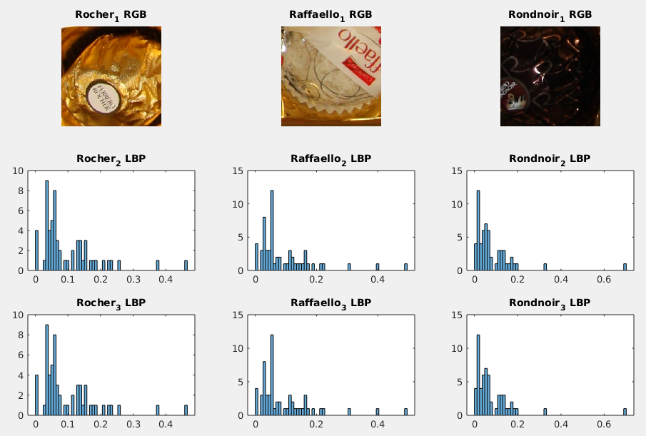
LBP

Slide 28
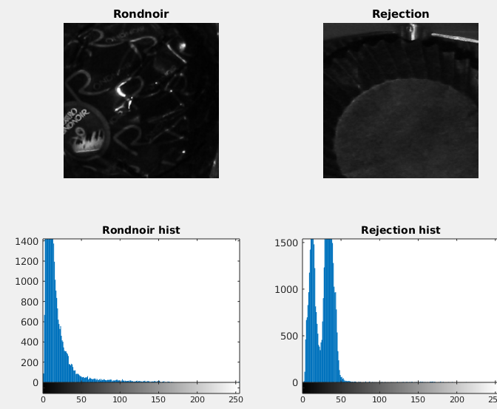
STD
Standard deviation of cuts converted in grayscale image

Slide 29
CLASSIFIER PERFORMANCE

Slide 30

DATASET PREPARATION
Cut,Label
IMG_10-10.png,1
IMG_10-11.png,1
IMG_10-12.png,1
IMG_10-13.png,1
IMG_10-14.png,1
IMG_10-15.png,1
IMG_10-16.png,1
IMG_10-17.png,1
IMG_10-18.png,1
IMG_10-7.png,1
IMG_10-8.png,1
IMG_10-9.png,1
IMG_11-10.png,1
IMG_11-11.png,1
IMG_11-12.png,1
IMG_11-13.png,1
IMG_11-14.png,1
IMG_11-15.png,1
IMG_11-16.png,1
IMG_11-17.png,1
IMG_11-18.png,1
IMG_11-7.png,1
IMG_11-8.png,1
IMG_11-9.png,1
IMG_12-10.png,1
IMG_12-11.png,1
IMG_12-12.png,1
IMG_12-13.png,1
IMG_12-14.png,1
IMG_12-15.png,1
IMG_12-16.png,1
IMG_12-17.png,1
IMG_12-18.png,1
IMG_12-7.png,1
IMG_12-8.png,1
IMG_12-9.png,1
IMG_13-10.png,1
IMG_13-11.png,1
IMG_13-12.png,1
IMG_13-13.png,1
IMG_13-14.png,1
IMG_13-15.png,1
IMG_13-16.png,1
IMG_13-17.png,1
IMG_13-18.png,1
IMG_13-7.png,1
A CSV file is manually populated with 888 ROI name and class, classes are defined below
Rocher
Raffaello
Rondnoir
Reject
ROIs have been automatically generated using previous steps, so the classification is computed on actual images.
IMG_10-10.png, class: Rocher

Slide 31


FEATURES ANALYSIS
Classifier type: 1-NN
Features: AVG+LBP
6-folds validation
ACCURACY = 97.6%

Slide 32

TEST MULTIPLE FEATURES COMBINED
1-NN Classifier
6-fold cross-validation
Accuracy

Slide 33

CONFUSION MATRIX
Most of misclassifications are about rejection class, which are classified as valid chocolates
Since only valid rocher have tags on it, we introduce a new feature in order to achieve a better accuracy.

Slide 34





NEW FEATURE
The feature consists in a region based segmentation. Regions are recursively splitted and then merged based on near regions with low variance. Eventually the average value of each region is computed and the lowest value is returned.
This new feature is useful for detect valid rocher vs rocher without tag. Also the classification between rocher and rejection class is easier.
Even if rocher, raffaello and rondnoir are not distinguishable using this feature, the avg feature is very different
Therefore there should be an overall improvement in classification

Slide 35

PERFORMANCE IMPROVEMENT
Classifier type: 1-NN
Features: AVG+LBP
6-folds validation
New feature
Improvement
ACCURACY = 97.6%
ACCURACY = 98.4%

Slide 36
CUTS CLASSIFICATION

Slide 37


ERROR DETECTION
An image mask is compared with static validity masks (that are different for each box type), no difference means the input image correctly matches a reference matrix, the box is correct.

Slide 38
RESULTS

Slide 39





RESULTS
After classification, all invalid results are transformed back to the original image and displayed in the output as blue circles.
Total boxes: 64
Correct boxes: 38
Incorrect boxes: 26
Correctly defined as compliant 30/38
Incorrectly defined as non-compliant 8/38
Correctly defined as non-compliant 24/26 Incorrectly defined as compliant 2/26
Overall accuracy: 84.37 %

Slide 40

COMMENTS
Some errors are caused by bugs in the box detection algorithm, when the contrast of the wood venis is too high, edges unuseful are detected and the result hough transform doesn’t match the real box. This results in a false positive rejection class classification.
The key for improving this kind of errors is to strengthen the box detection algorithm, either by using more complex segmentation algorithm (combining various edge detection methods, pixel based classification for table/non-table, general table/non-table classification) or by improving the existing solution with more advanced filtering, morphology correction or by combining different color spaces/pipelines

Slide 41

COMMENTS
Dynamic ROI cropping is probably the second most impactful upgrade that could be developed in order to increase the overall accuracy. Even though the perspective is corrected in a previous step, the precision is still somewhat imprecise, and the percentage based cutting that is currently implemented could lead to some miscalculation.
Many tests have been performed to improve the crop quality, the most successful (but still not valid) have been:
Using superpixel oversegmentation to more accurately cut ROIs. Fails because the color between rocher and the box is too similar, the number of superpixel cannot be calculated.
Edge detection and hough analysis to detect line patterns, valid idea but infeasible, edge detection is not accurate enough
Pattern matching, computationally infeasible, too many versions of each chocolate have to be computed

Slide 42
FAILED TESTS

Slide 43


VERTICES DETECTION
Detecting vertices is done by sliding a virtual line diagonally and vertically, then the method that gives the most accurate result is selected automatically. Only 3 vertices can be detected when the box is outside the viewport.
Using the detected vertices is possible to rotate, shear and crop the box using linear transformations.

Slide 44






PIXEL BASED CLASSIFICATION
As for the first step, qualitative color space analysis is performed on a sample of various classes. HSV channels shows a clear distinction between the three classes. Mathematical morphology is then performed on the classificator result to separate the various ROIs.
Mathematical morphology is insufficient and the output image cannot be correctly separated. Furthermore box and rocher classes are virtually indistinguishable.
Result not acceptable

Slide 45
CONTRIBUTIONS
Gianluca Giudice 60%
Image binarization
Feature analysis
Classifier
Error plot
Matteo Formenti 40%
Vertices calculation
ROI isolation
Slides

